Slide 1
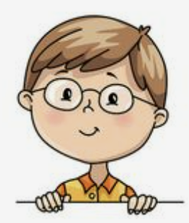
I’m dancing with dad.
Unit 8
Lesson 6

Slide 2
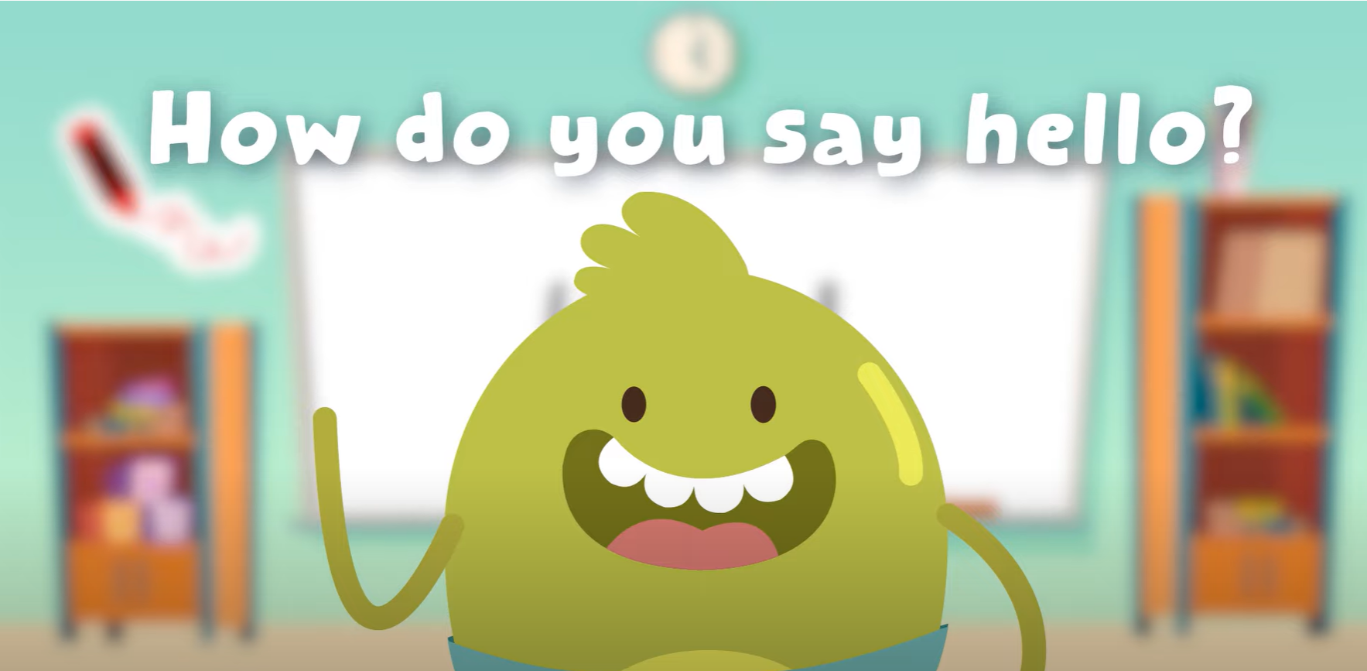
HELLO SONG

Slide 3
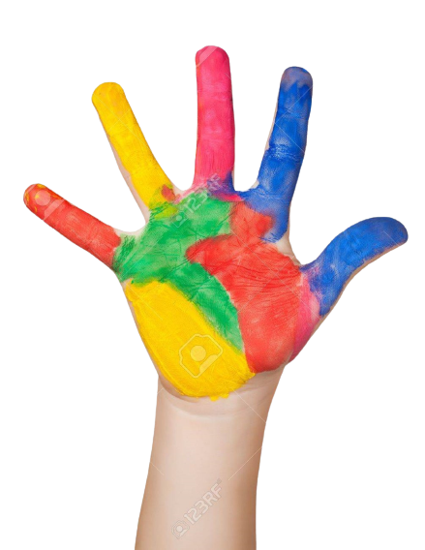
Give me Five

Slide 4
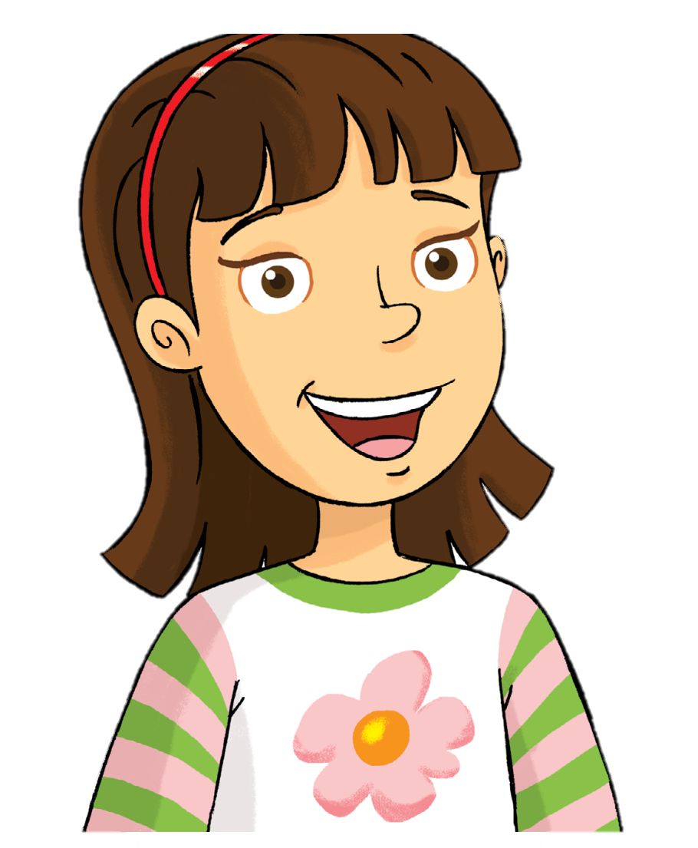
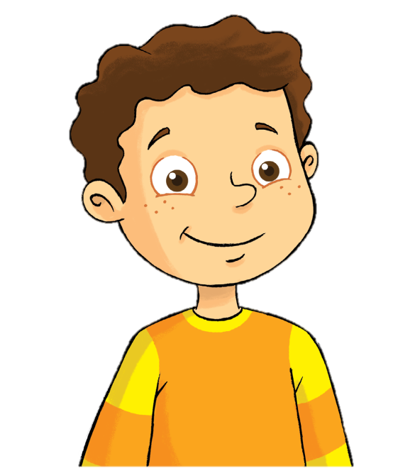
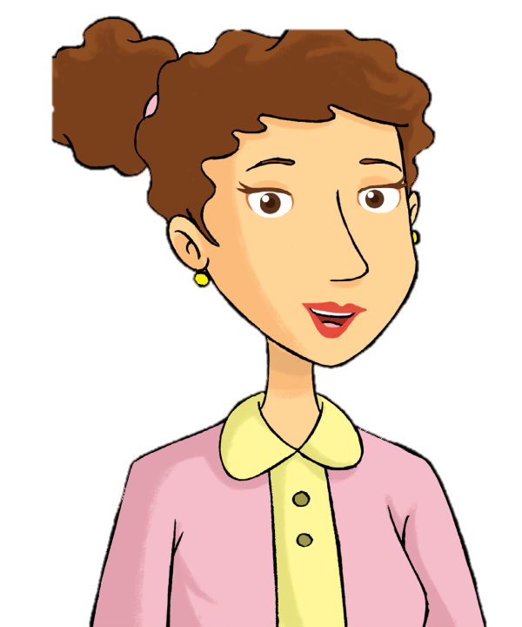
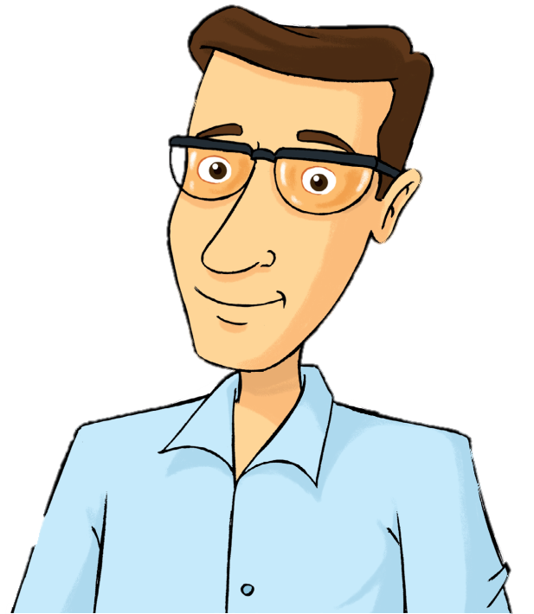
Look and Say
Rosy
Billy
mom
dad

Slide 5
Watch and Answer

Slide 6
Good job!

Slide 7
Listen and Number

Slide 8
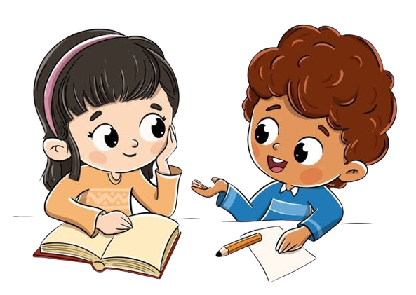
Work in Pairs
Notes:
Listen again and check answers.
Check answer with sachso.edu.vn

Slide 9
Good job!

Slide 10
Work in Pairs
Notes:
Ask and answer
What’s he doing?
He’s dancing.

Slide 11
Good job!

Slide 12
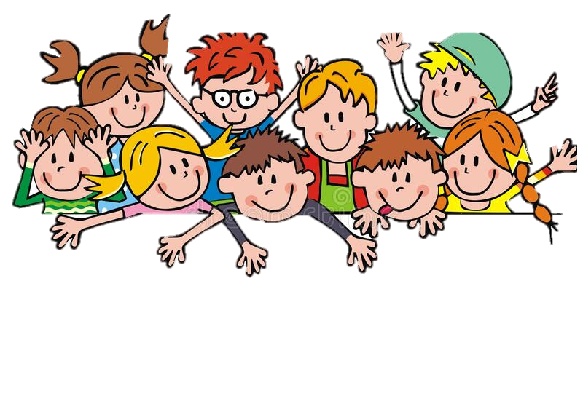
Game
Notes:
Choose a photo of your Tet holiday and say what you’re doing.
I’m eating and drinking.

Slide 13
Good job!

Slide 14
Read and Write
Write ing
ing
I’m eat__________ some cake.
ing
She’s drink__________ water.
ing
He’s talk______ with his family at the party.

Slide 15
Read and Write
Write about your family at Tet.
It’s Tet holiday. My dad is ______________________. My mom is _______________.
I’m ___________________. We’re happy.
Cleaning our house
cooking
helping my mom

Slide 16
Work in Pairs
Notes:
Peer-checking students’ answers.

Slide 17
Good job!

Slide 18
Game

Slide 19
Good job!

Slide 20
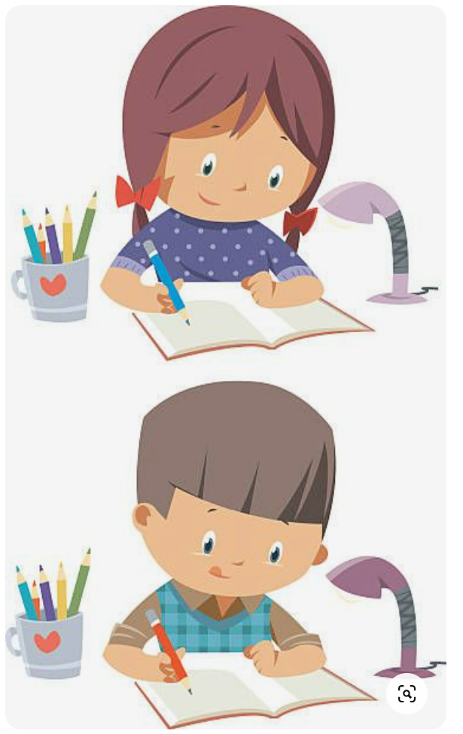
Homework

Slide 21
THANK YOU!

