Slide 1


Grade 5
2

Slide 2



Slide 3
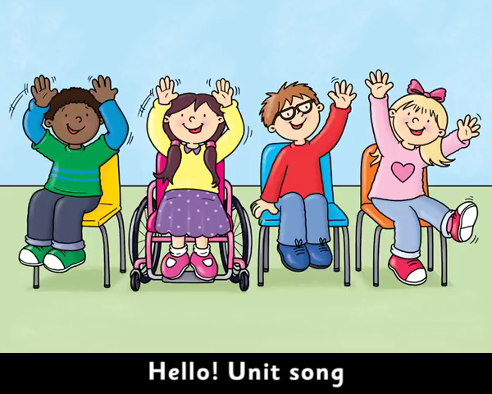

Slide 4
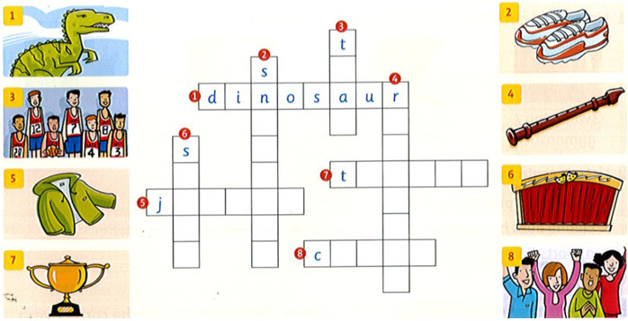
Complete the crossword

Slide 5
Complete the crossword
e
e
m
e
a
c
t
k
r
o
p
h
y
a
c
k
e
t
r
g
r
d
e
s
h
e
e
r
r

Slide 6
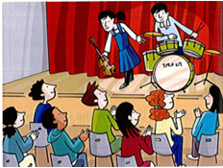
Write: cheered concert drums violin stage audience
Emily and Joe are both ten. On Wednesdays they go to music lessons. Emily is learning the ¹_violin_ and Joe is learning the ²____ . Last week they performed in a ³_____ at the music at school. Emily went up on the ⁴_____ first. Then it was time for Joe. They were nervous, but they played well. The ⁵______ clapped and ⁶______ . Emily and Joe were very proud.
drums
concert
stage
audience
cheered

Slide 7

GAME TIME

Slide 8

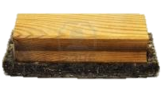
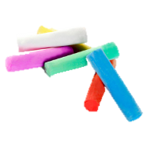
GRAMMAR – PAST SIMPLE
PRACTICE
Did she sing a song last night?
No, she didn’t.
What did she do?
She clapped her hands.

Slide 9

GRAMMAR – PAST SIMPLE
PRACTICE
Did they talk a lot yesterday?
Yes, they did.

Slide 10

GRAMMAR – PAST SIMPLE
PRACTICE
Did he drive a car last Sunday?
No, he didn’t.
What did he do?
He ran to the park.

Slide 11
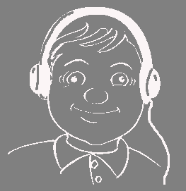
GRAMMAR – PAST SIMPLE
PRACTICE
Did he do homework yesterday evening?
No, he didn’t.
What did he do?
He listened to music.

Slide 12

GRAMMAR – PAST SIMPLE
PRACTICE
Did he sing a song two days ago?
Yes, he did.

Slide 13

GRAMMAR – PAST SIMPLE
PRACTICE
Did he eat dinner with his friends last night?
No, he didn’t.
What did he do?
He drank beer.

Slide 14

GRAMMAR – PAST SIMPLE
PRACTICE
Did he write an email yesterday?
No, he didn’t.
What did he do?
He drove a car.

Slide 15

GRAMMAR – PAST SIMPLE
PRACTICE
Did he play soccer last weekend?
Yes, he did.

Slide 16

GRAMMAR – PAST SIMPLE
PRACTICE
Did he sleep yesterday?
No, he didn’t.
What did he do?
He swam in the pool.

Slide 17
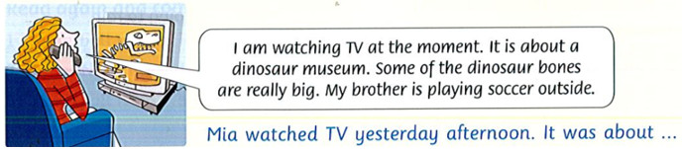
Read. Then write what Mia did yesterday afternoon.

Slide 18
Match the question with the answer.
a. Yes, I ate dinner at home.
1. Where did you go yesterday?
2. What did you see?
3. Did you buy anything there?
4. Did you eat after the movie?
5. What did you think of the movie?
b. I went to the movies.
c. I thought it was great.
d. I saw a movie about tigers.
e. Yes, I bought a drink.

Slide 19
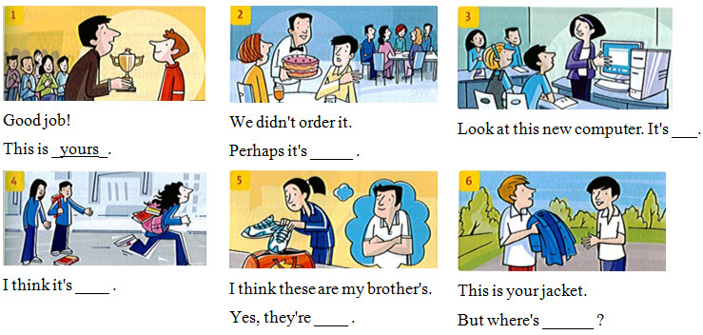
Write: hers theirs mine yours ours his
theirs
yours
hers
his
mine

Slide 20
Write the words under the correct sounds
blue light bike coat sky nose room flute blow
Long i bike | Long o | Long u

Slide 21
Write the words under the correct sounds
blue light bike coat sky nose room flute blow
Long i Bike Light Sky | Long o Coat Nose Blow | Long u Blue Room flute

Slide 22
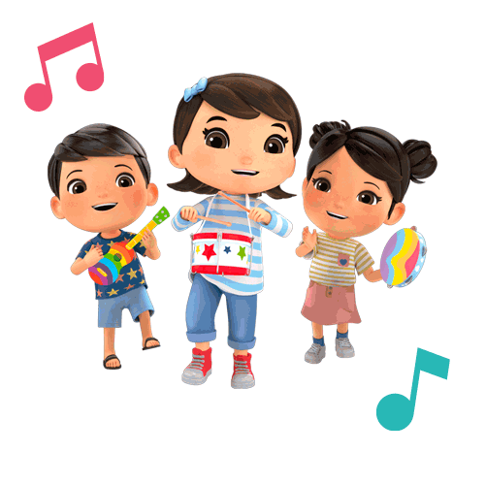
LISTEN AND SING

Slide 23
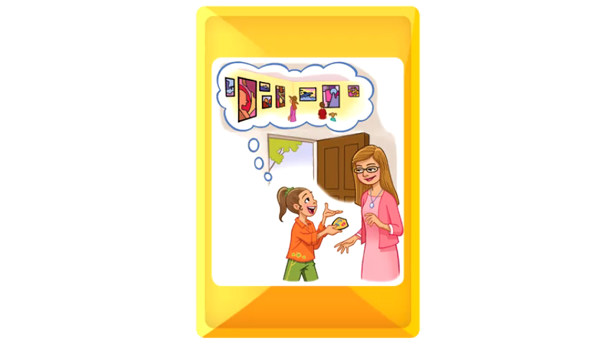

Slide 24
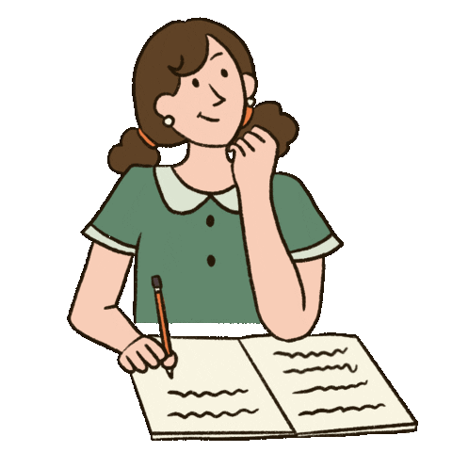
WORKBOOK TIME

Slide 25
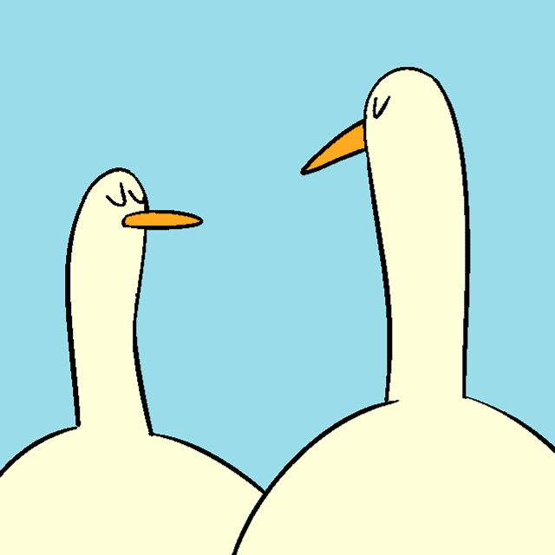
GOODBYE!!!

Slide 26


