Slide 1
Phòng GDĐT huyện Hóc Môn Trường TH Tam Đông
Grade: 4E
Week: 22
Uint: 8 Let’s buy presents!
Lesson : 4 Phonics
Teacher: Lê Thị Thu Hương

Slide 2
Notes:
https://www.youtube.com/watch?v=pqDEwPi7vxg

Slide 3
Good job!

Slide 4
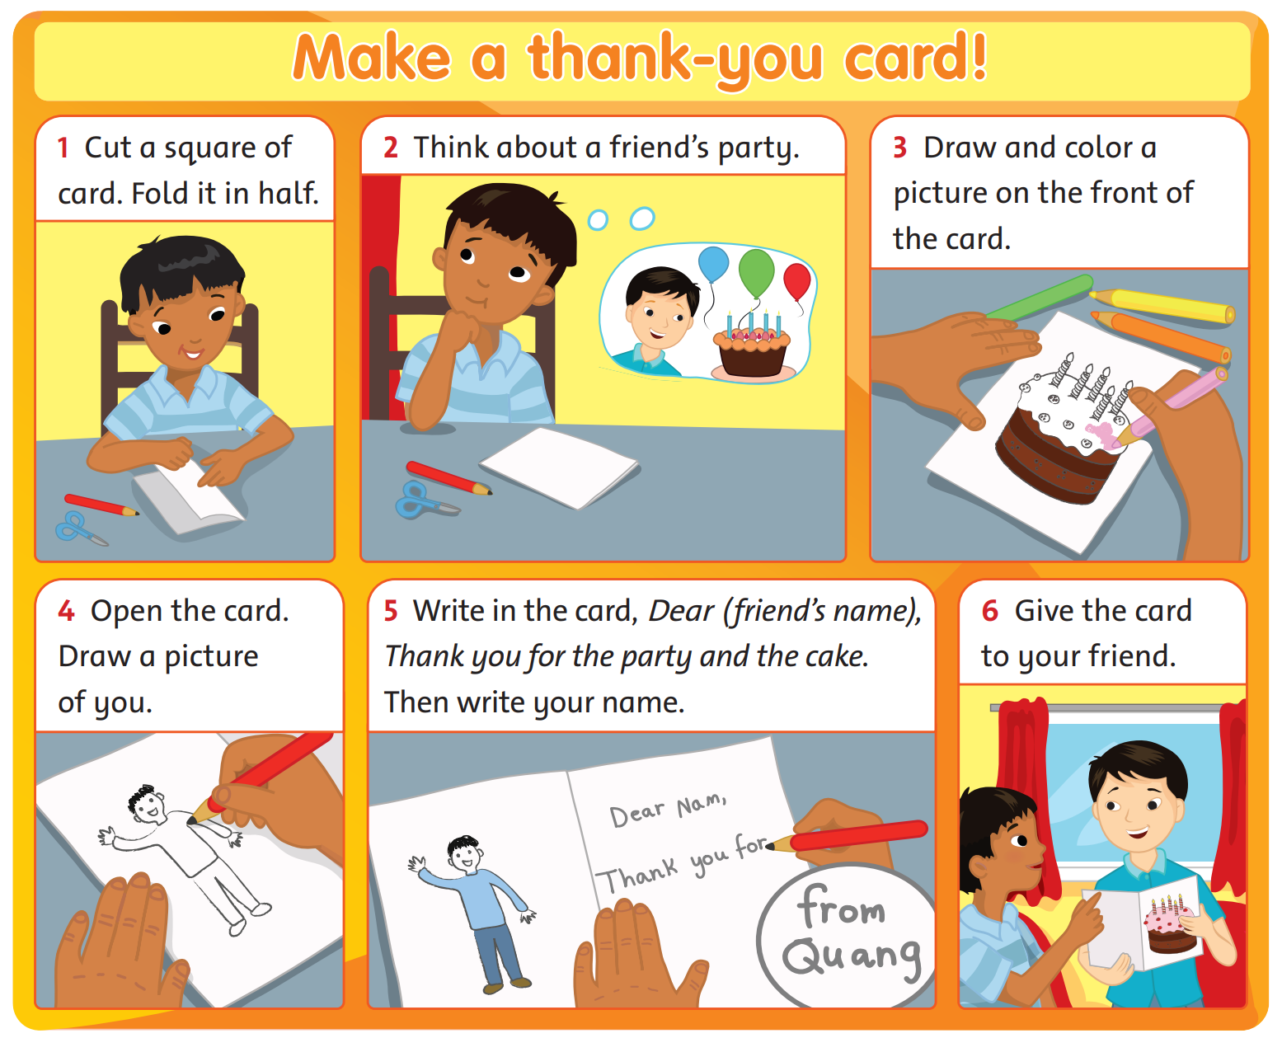
Look and Answer.
Notes:
* Look at the pictures. What is the card for?
Ask children to look at the pictures. Ask What is the boy making?

Slide 5
Listen, Point and Read.
Notes:
* Listen and read. Track 103
Play the recording. Children listen and follow along.

Slide 6
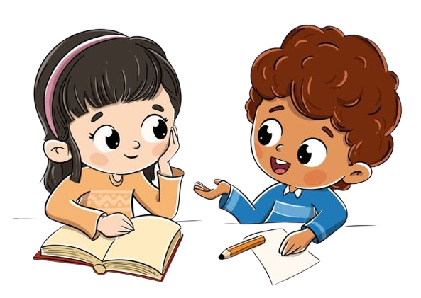
Listen and Answer.
64
1. What’s the first thing the boy does?
2. What does the boy draw in the card?
3. What does he write?
4. Who does the boy give the card to?
5. Does his friend like the card?
Notes:
Ask comprehension questions, e.g. What does the boy draw in the card? What does he write? Does his friend like the card?
Play the recording a second time.
Students work in pairs to ask and answer the questions.
Invite some volunteers to answer the questions in the front.

Slide 7
Let’s check!
64
1. What’s the first thing the boy does?
Cut a square of card.
Notes:
Invite some volunteers to answer the questions in the front.

Slide 8
Let’s check!
64
2. What does the boy
draw in the card?
He draws a picture.
Notes:
Invite some volunteers to answer the questions in the front.

Slide 9
Let’s check!
64
3. What does he write?
Dear Nam,
Thank you for the party
and the cake.
His name, Quang.
Notes:
Invite some volunteers to answer the questions in the front.

Slide 10
Let’s check!
64
4. Who does the boy give
the card to?
He gives to his friend.
Notes:
Invite some volunteers to answer the questions in the front.

Slide 11
Let’s check!
64
5. Does his friend like the card?
Yes, he does.
Notes:
Invite some volunteers to answer the questions in the front.

Slide 12
Read and Put the sentences in the correct order.
Open the card. _____
Draw a picture on the front of the card. ______
Give the card to your friend. _______
Write in the card. _______
Draw a picture of you. ______
1
Notes:
* Read again and put the sentences in the correct order.
Ask children to look at the exercise in their books. Explain that the sentences are in the wrong order. Ask What’s the first thing you do? Elicit the correct answer and show the example answer.

Slide 13
Let’s check!
Open the card. _____
Draw a picture on the front of the card. ______
Give the card to your friend. _______
Write in the card. _______
Draw a picture of you. ______
2
1
5
4
3
Notes:
Answers
a 2 b 1 c 5 d 4 e 3

Slide 14
Game: MUSICAL CHAIRS!
Do you like cards?
Why?
Notes:
* Do you like cards and presents? Why?
Ask the questions around the class.
Encourage individuals to ask other children the question.

Slide 15
Game: MUSICAL CHAIRS!
Do you like presents?
Why?
Notes:
- Play again with another question.

Slide 16
Game: MUSICAL CHAIRS!
Do you like birthday cake?
Why?
Notes:
- Play again with another question.

Slide 17
Game: MUSICAL CHAIRS!
What do you like best?
Notes:
- Play again with another question.

Slide 18
 You will estimate yourself on this lesson.
Ẽ
Excellent | Good | Not good

Slide 20
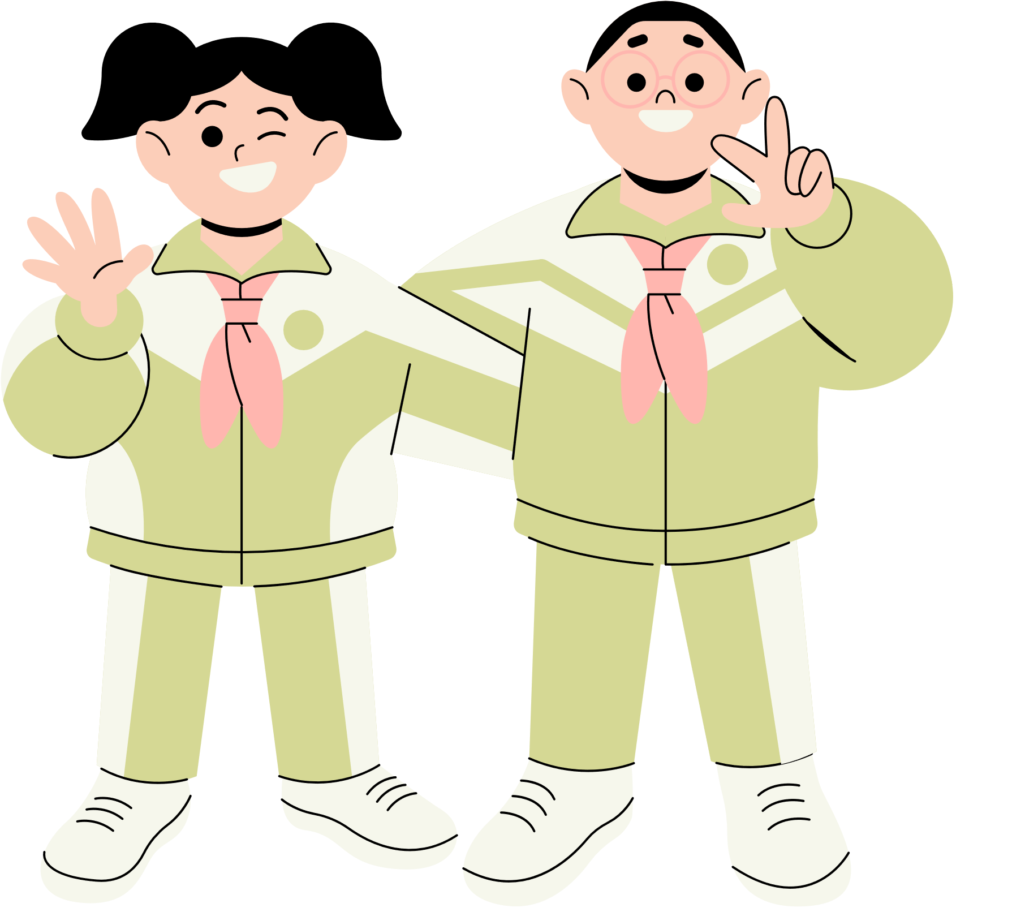
Thank You!
See You Next Time.
Notes:
https://www.youtube.com/watch?v=SRyFiVeNjWs

