Slide 1
Unit 9:
TOYS

Slide 2
WARM UP

Slide 4
VOCABULARY

Slide 11
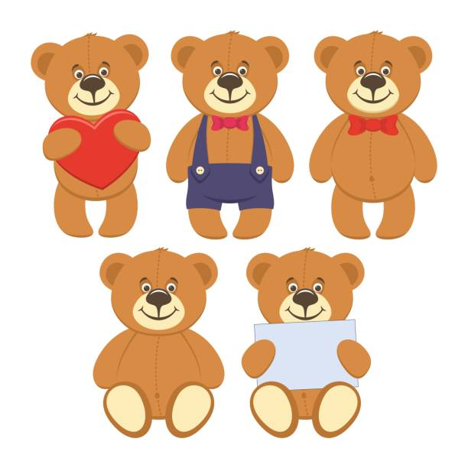
Ten teddy bears

Slide 12
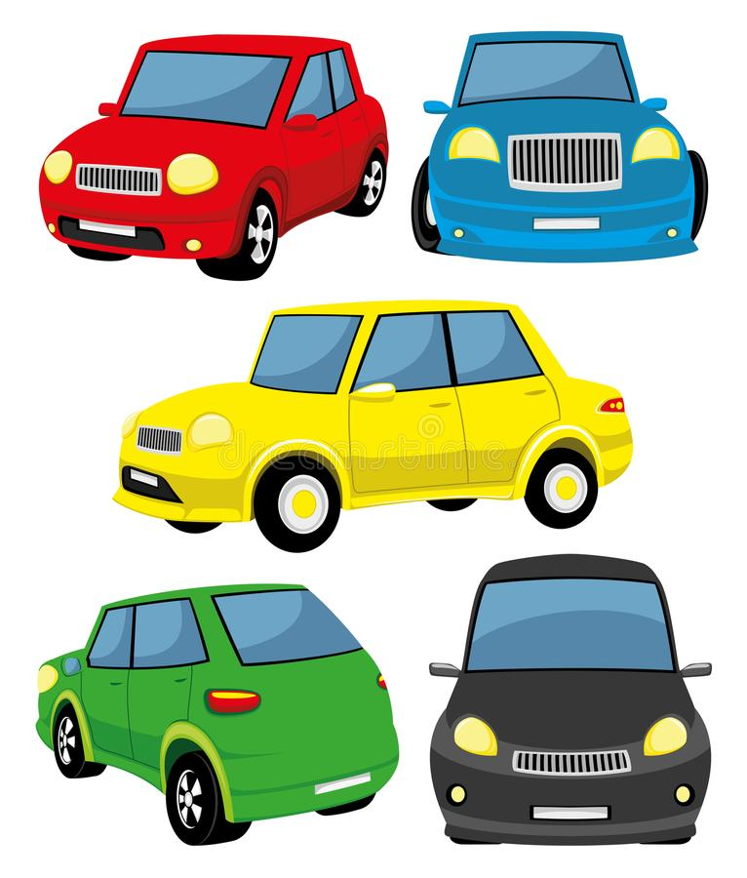
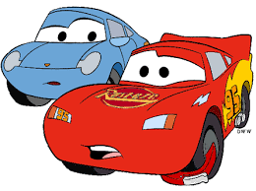
v
How many cars?
Seven cars.

Slide 13
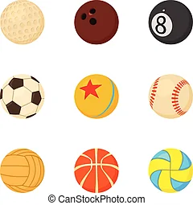
How many balls?
Nine balls.

Slide 14
How many teddy bears?
One teddy bear.

