Slide 1



Slide 2
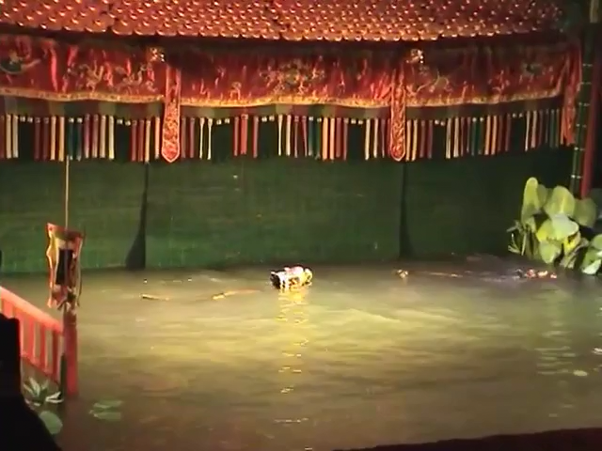

Slide 3
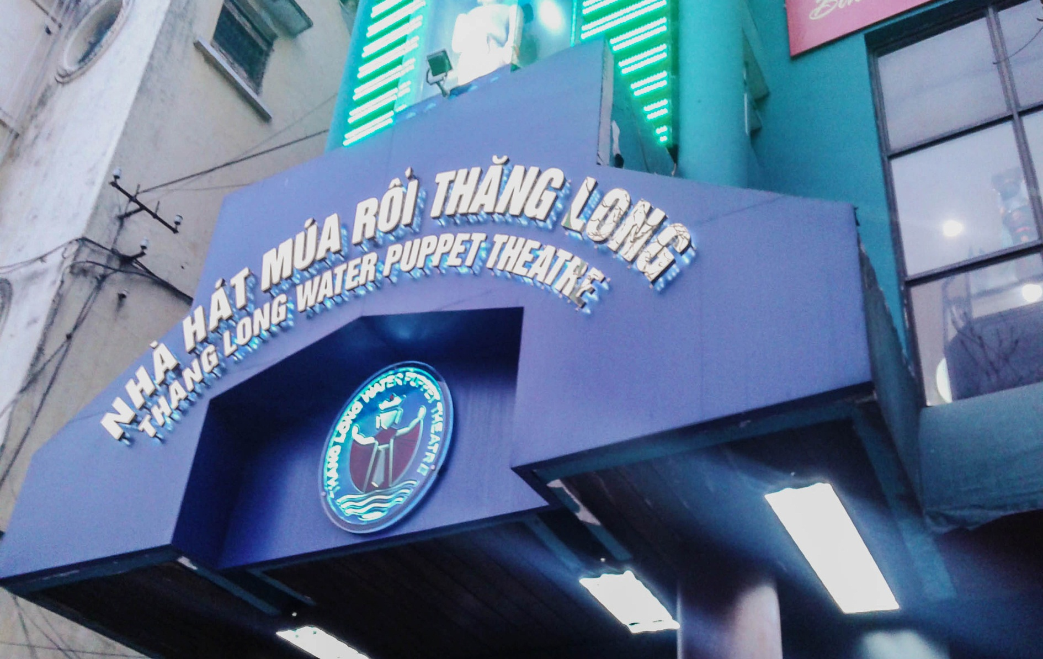

Slide 4
UNIT 7- go back to the traffic lights
Lesson 5 : skills time!

Slide 5
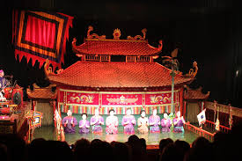

Water puppet theaters started in the Red River Delta a thousand years ago. But they are still popular today all over Viet Nam. The puppets are usually made from wood and painted in different colors with a special type of paint that stays in water.
Red River Delta
popular
Water puppet theater

Slide 6
The stage is a pool of water, and the puppets move over the top of it. When water puppets first started, the stage was a rice field. Today, people hide behind a screen so no one sees them. They use sticks to make the puppets move and act out the story. The stories are usually about Vietnamese folktales and legends. Sometimes there is a band that plays Vietnamese music.
rice field
screen
folktales
legends

Slide 7
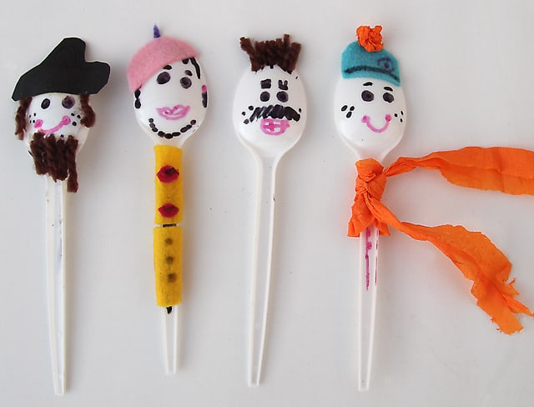
Make your own water puppets.
You can make your own water puppets!
Take a plastic spoon and use pens or colored paper to draw a face and costume. Fill a bowl with water and put the spoon in the water so that you can move the puppet. Be careful! Don’t get the puppet’s costume wet. Ask your friends to make some more puppets so that you can tell a story together.
plastic

Slide 8
4. The puppets play music.
Read again and write T( true) or F( false)?
1. Water puppet theaters started in Viet Nam.
T
2. The puppets are usually made from plastic.
F
3. Water puppets started in rice fields.
T
F
5. You can make water puppets with plastic spoons.
T

Slide 9
Water puppet theaters started in the Red River Delta a thousand years ago. But they are still popular today all over Viet Nam. The puppets are usually made from wood and painted in different colors with a special type of paint that stays in water.
The stage is a pool of water, and the puppets move over the top of it. When water puppets first started, the stage was a rice field. Today, people hide behind a screen so no one sees them. They use sticks to make the puppets move and act out the story. The stories are usually about Vietnamese folktales and legends. Sometimes there is a band that plays Vietnamese music.
Make your own water puppets.
You can make your own water puppets!
Take a plastic spoon and use pens or colored paper to draw a face and costume. Fill a bowl with water and put the spoon in the water so that you can move the puppet. Be careful! Don’t get the puppet’s costume wet. Ask your friends to make some more puppets so that you can tell a story together.

Slide 10
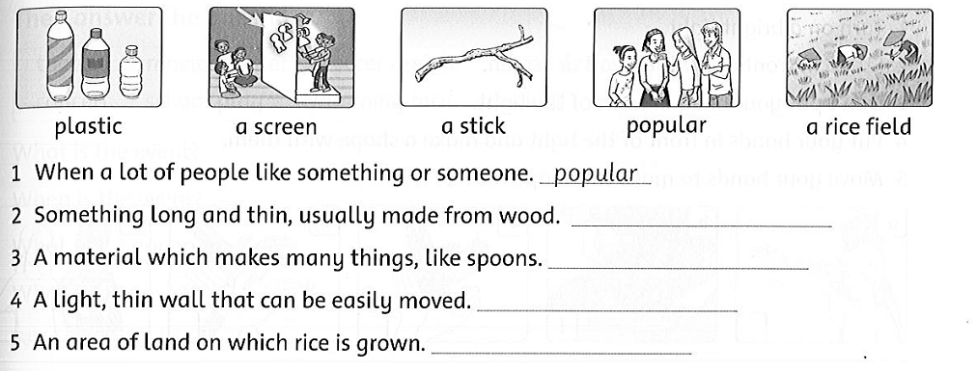
Look and read.
Choose the correct word and write it on the line.
a stick
plastic
a screen
a rice field

Slide 20
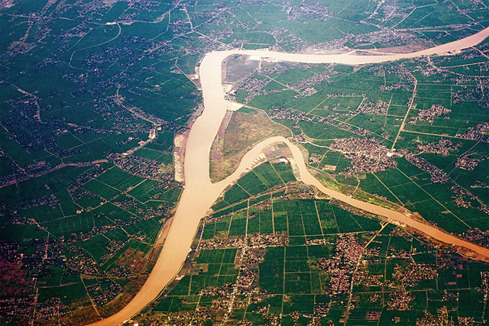
Red River Delta(n):
Đồng bằng sông Hồng

Slide 21
popular (adj):
when a lot of people like something or someone.
( phổ biến)

Slide 22
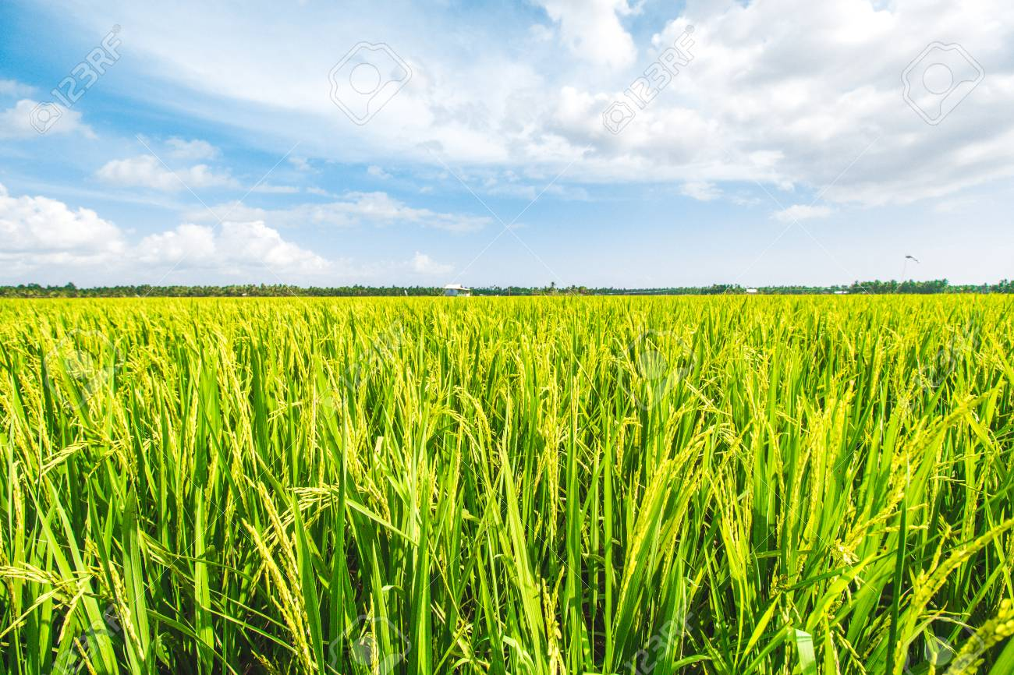
rice field (n)

Slide 23
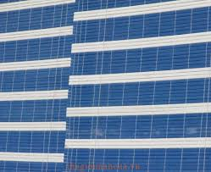
screen (n)

Slide 24
folktale(n):
E.g. Con cóc là cậu ông trời
legend(n):
E.g. Tấm cám

Slide 25
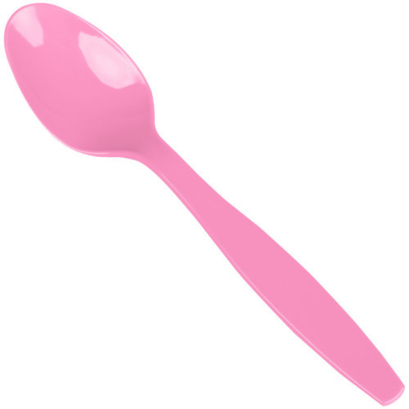
plastic (adj)

Slide 26
Water puppet theaters started in the Red River Delta a thousand years ago. But they are still popular today all over Viet Nam. The puppets are usually made from wood and painted in different colors with a special type of paint that stays in water.
The stage is a pool of water, and the puppets move over the top of it. When water puppets first started, the stage was a rice field. Today, people hide behind a screen so no one sees them. They use sticks to make the puppets move and act out the story. The stories are usually about Vietnamese folktales and legends. Sometimes there is a band that plays Vietnamese music.
Make your own water puppets.
You can make your own water puppets!
Take a plastic spoon and use pens or colored paper to draw a face and costume. Fill a bowl with water and put the spoon in the water so that you can move the puppet. Be careful! Don’t get the puppet’s costume wet. Ask your friends to make some more puppets so that you can tell a story together.

Slide 27
Water puppet theaters started in the Red River Delta a thousand years ago. But they are still popular today all over Viet Nam. The puppets are usually made from wood and painted in different colors with a special type of paint that stays in water.
The stage is a pool of water, and the puppets move over the top of it. When water puppets first started, the stage was a rice field. Today, people hide behind a screen so no one sees them. They use sticks to make the puppets move and act out the story. The stories are usually about Vietnamese folktales and legends. Sometimes there is a band that plays Vietnamese music.
Make your own water puppets.
You can make your own water puppets!
Take a plastic spoon and use pens or colored paper to draw a face and costume. Fill a bowl with water and put the spoon in the water so that you can move the puppet. Be careful! Don’t get the puppet’s costume wet. Ask your friends to make some more puppets so that you can tell a story together.

Slide 28
Water puppet theaters started in the Red River Delta a thousand years ago. But they are still popular today all over Viet Nam. The puppets are usually made from wood and painted in different colors with a special type of paint that stays in water.
The stage is a pool of water, and the puppets move over the top of it. When water puppets first started, the stage was a rice field. Today, people hide behind a screen so no one sees them. They use sticks to make the puppets move and act out the story. The stories are usually about Vietnamese folktales and legends. Sometimes there is a band that plays Vietnamese music.
Make your own water puppets.
You can make your own water puppets!
Take a plastic spoon and use pens or colored paper to draw a face and costume. Fill a bowl with water and put the spoon in the water so that you can move the puppet. Be careful! Don’t get the puppet’s costume wet. Ask your friends to make some more puppets so that you can tell a story together.

Slide 29
Water puppet theaters started in the Red River Delta a thousand years ago. But they are still popular today all over Viet Nam. The puppets are usually made from wood and painted in different colors with a special type of paint that stays in water.
The stage is a pool of water, and the puppets move over the top of it. When water puppets first started, the stage was a rice field. Today, people hide behind a screen so no one sees them. They use sticks to make the puppets move and act out the story. The stories are usually about Vietnamese folktales and legends. Sometimes there is a band that plays Vietnamese music.
Make your own water puppets.
You can make your own water puppets!
Take a plastic spoon and use pens or colored paper to draw a face and costume. Fill a bowl with water and put the spoon in the water so that you can move the puppet. Be careful! Don’t get the puppet’s costume wet. Ask your friends to make some more puppets so that you can tell a story together.

Slide 30
Water puppet theaters started in the Red River Delta a thousand years ago. But they are still popular today all over Viet Nam. The puppets are usually made from wood and painted in different colors with a special type of paint that stays in water.
The stage is a pool of water, and the puppets move over the top of it. When water puppets first started, the stage was a rice field. Today, people hide behind a screen so no one sees them. They use sticks to make the puppets move and act out the story. The stories are usually about Vietnamese folktales and legends. Sometimes there is a band that plays Vietnamese music.
Make your own water puppets.
You can make your own water puppets!
Take a plastic spoon and use pens or colored paper to draw a face and costume. Fill a bowl with water and put the spoon in the water so that you can move the puppet. Be careful! Don’t get the puppet’s costume wet. Ask your friends to make some more puppets so that you can tell a story together.

