Slide 1


WARMLY
WELCOME TO CLASS 3/2
Presented by Ms. Nguyệt

Slide 2


Wednesday, October 21st 2015
Unit 4
Lesson one:
Words

Slide 3

Review: salad, noodles, pizza
milkshake,
chicken

Slide 4

art

Slide 5

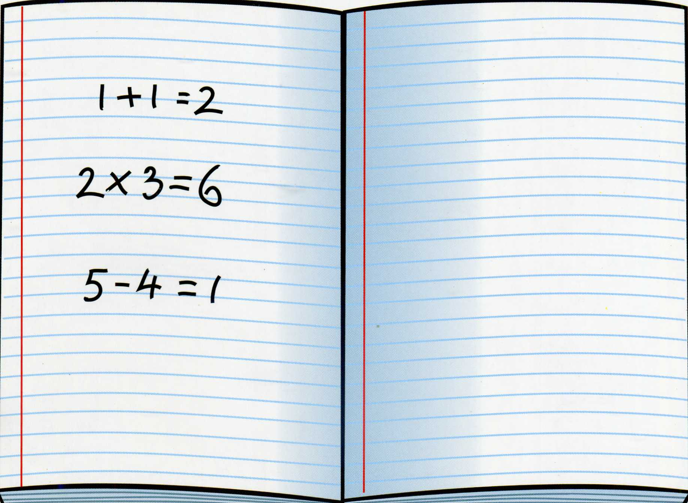
Math

Slide 6

English

Slide 7

P.E

Slide 8




music

Slide 9

Vietnamese

Slide 10


Science

Slide 11

_ Open your student book with page 28
_ Listen, point and repeat(Track_38.mp3)

Slide 12
Game 1: Passing ball game.
Game 2: Lucky numbers.

Slide 13
math
hamt
vietnamese
neitameves
shilgne
english
.EP
P.E
art
tar
music
sumic
science
sicence

Slide 14

Telling story:
The clever crow

Slide 15

Many Thanks for your attendance.
Good bye!

