Slide 1



PEOPLE’S COMMITTEE OF DISTRICT 12
NGUYEN DU PRIMARY SCHOOL
WELCOME TO GRADE 5
Presented by Ms.Ñieåu

Slide 2


Slide 3


1. vocabulary
2. workbook
3. homework

Slide 4
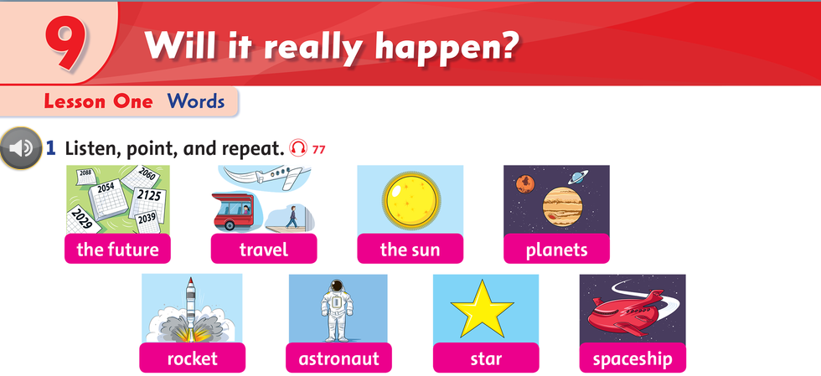

Slide 5
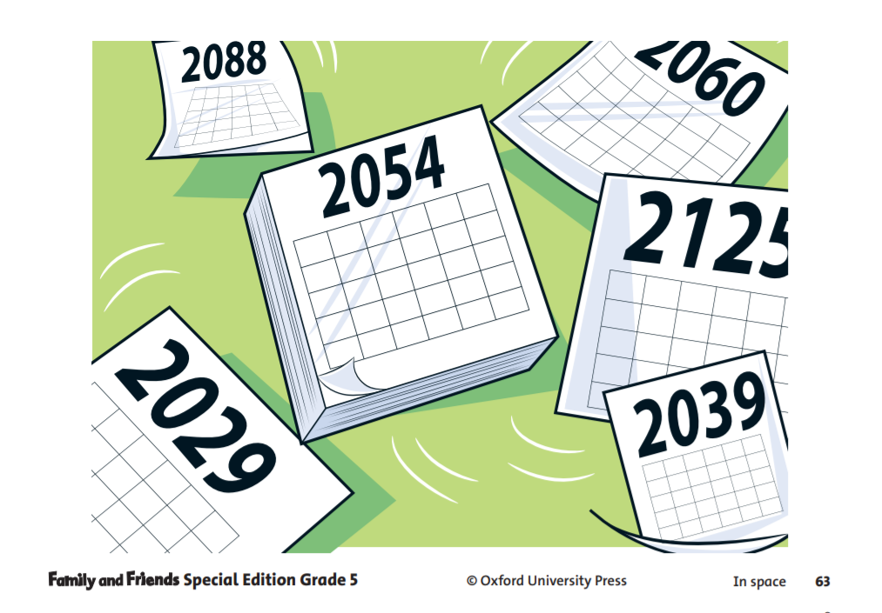



Slide 6
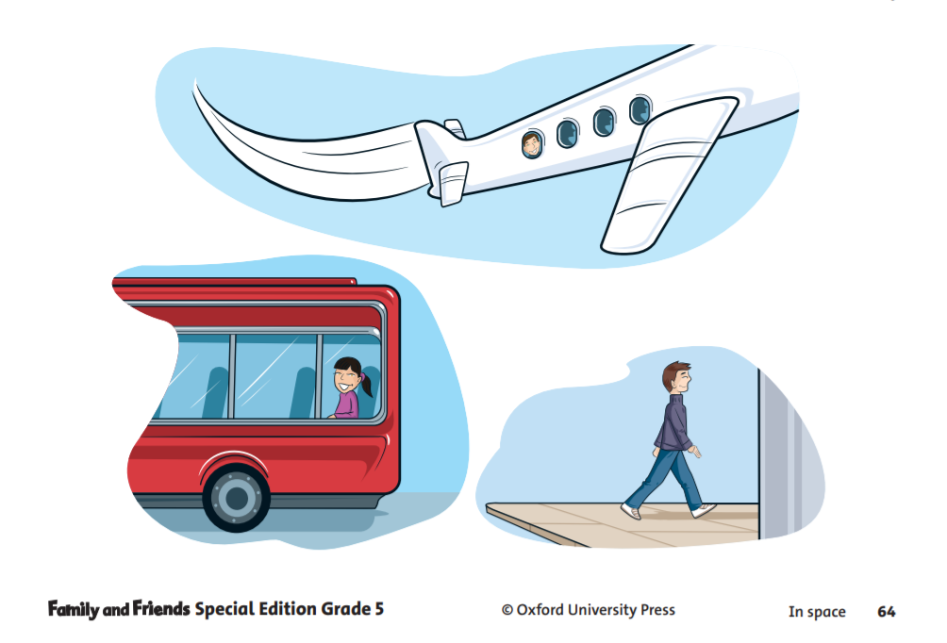




Slide 7
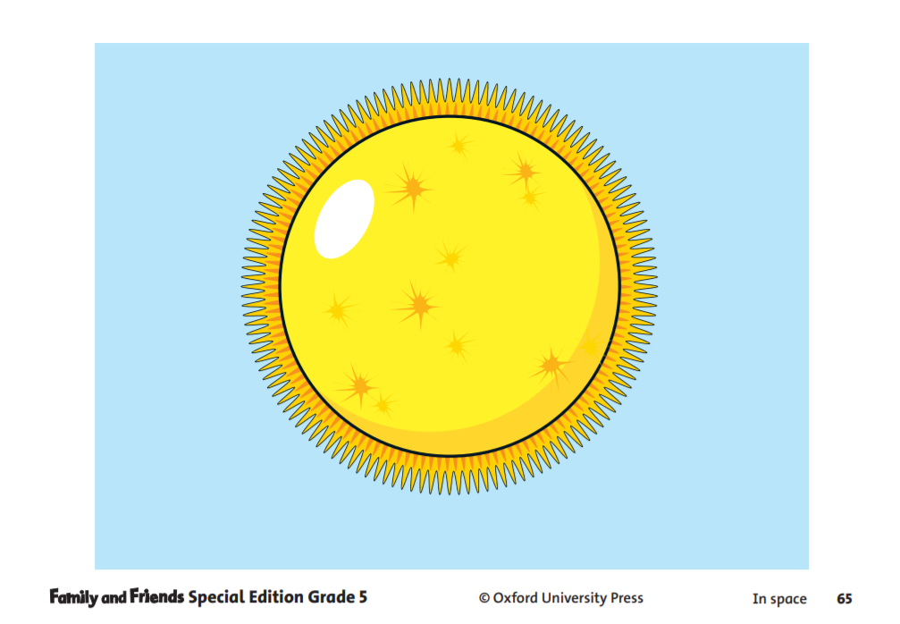



Slide 8
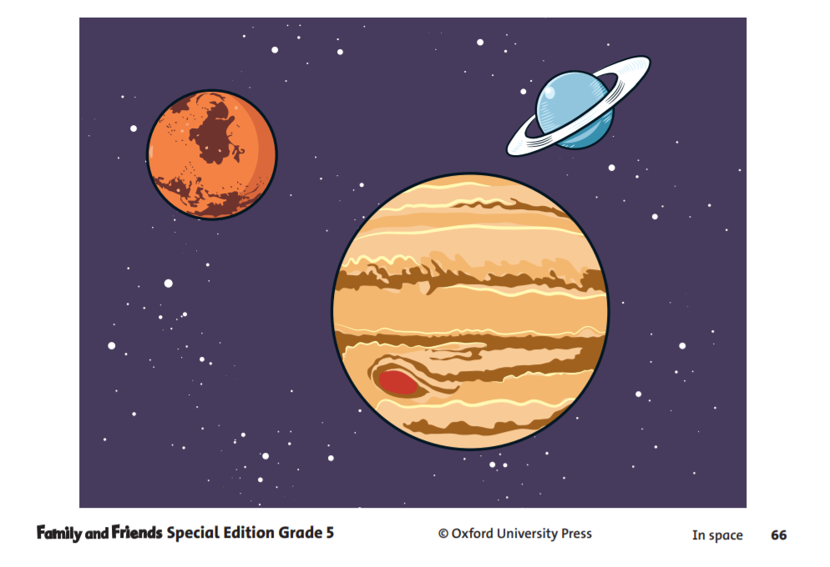



Slide 9
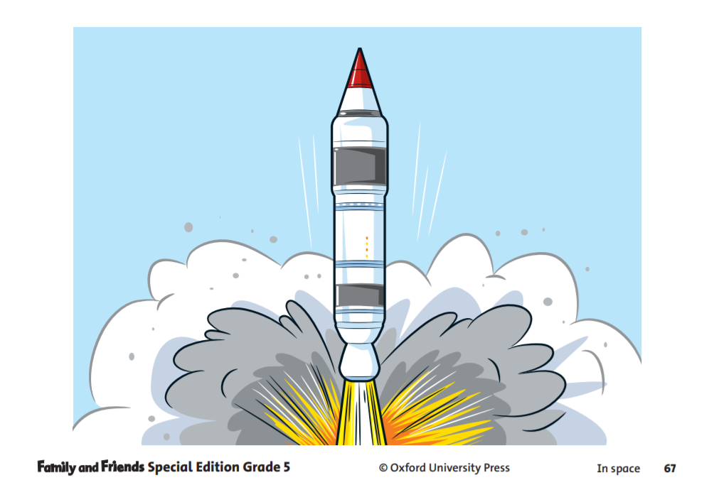



Slide 10
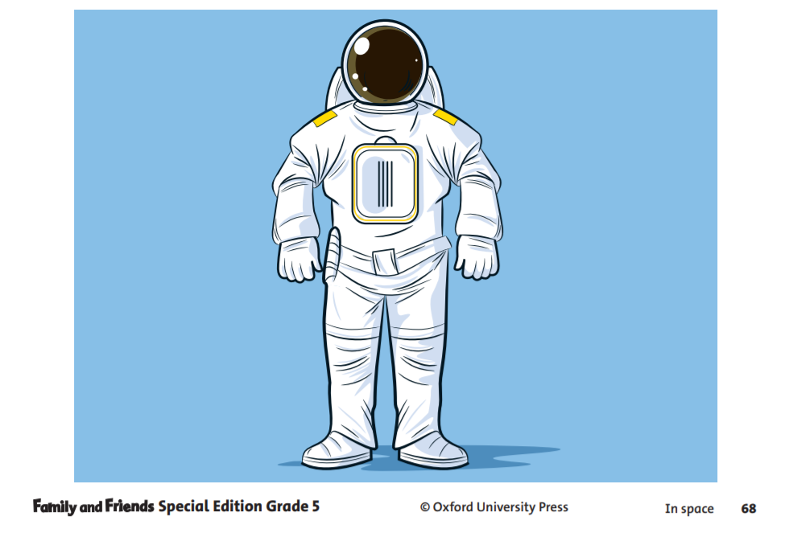


The astronaut fly into space.

Slide 11




Slide 12
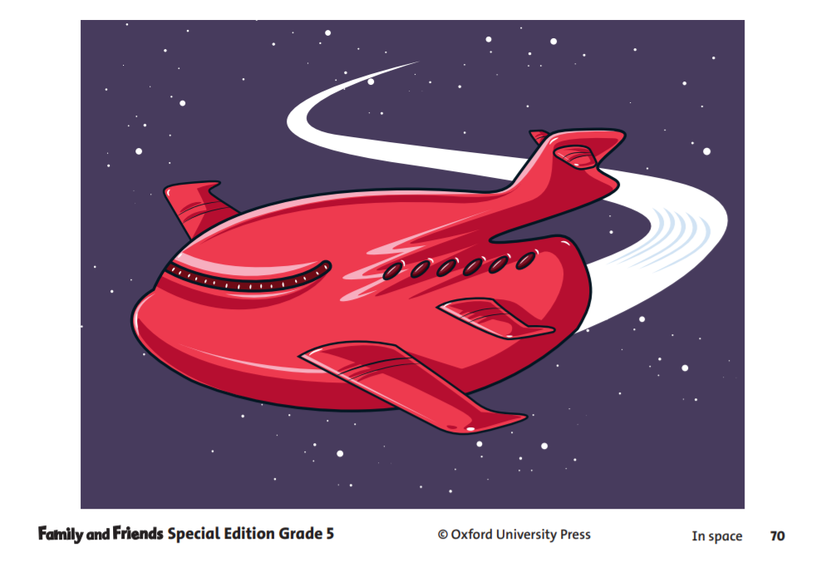

The spaceship fly into space.

Slide 13


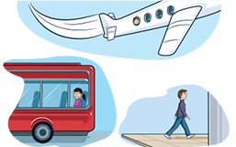














GUESSING GAME

Slide 14

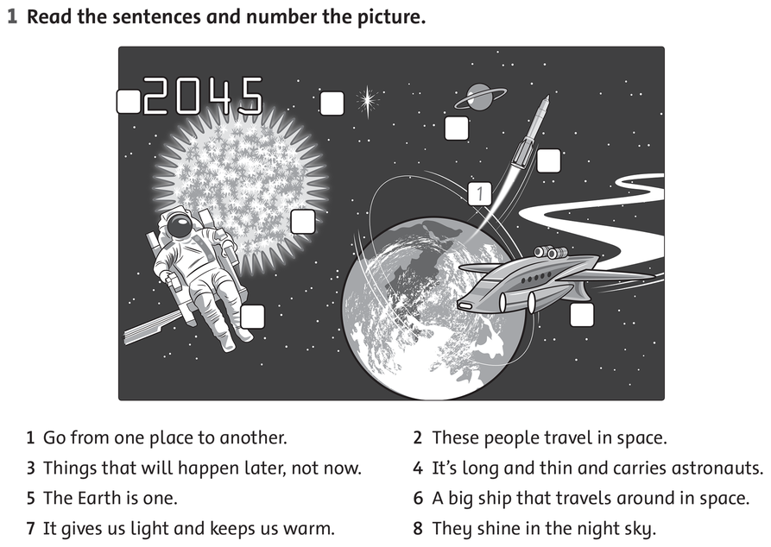
WB Page 60
3
8
5
4
1
7
2
6

Slide 15
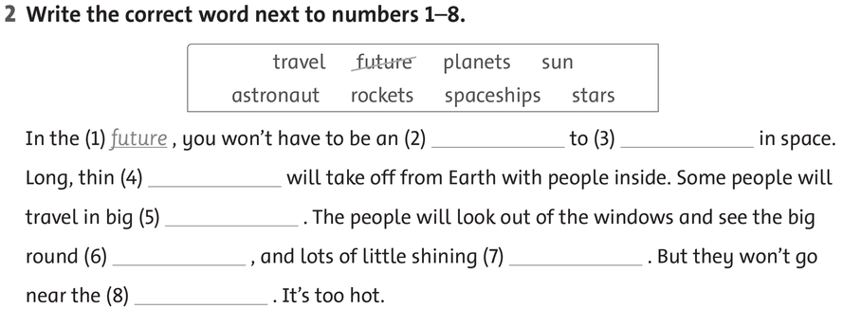
WB page 60
future
astronaut
travel
rockets
spaceships
planets
stars
sun

Slide 16
Copy words 3 lines

Slide 17



