Slide 1


PEOPLE’S COMMITTEE OF DISTRICT 12
NGUYEN DU PRIMARY SCHOOL
WELCOME TO GRADE 5
Presented by Ms.Ñieåu

Slide 2
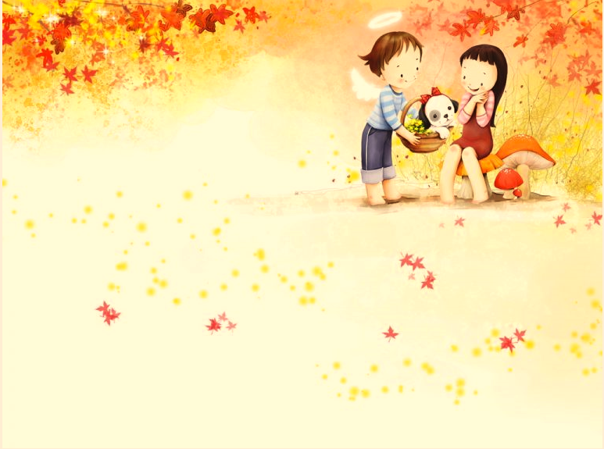
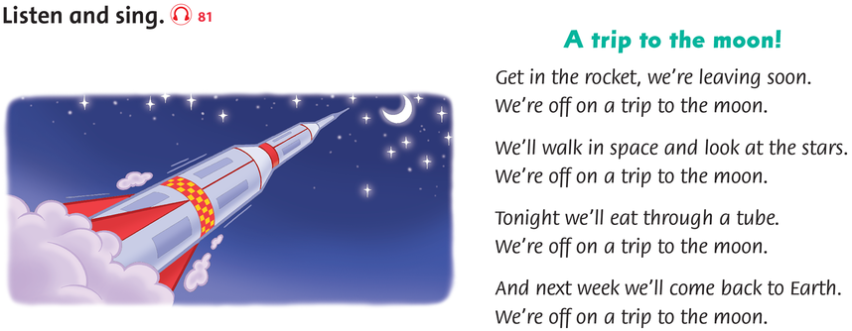


Slide 3
Unit 9: SKILLS TIME!
Lesson 5 - Reading
Lesson 6 - listening

Slide 4

Lesson 5 - Reading
Ask and answer the questions
1. Will there be more people?
2. Will it be hotter?
3. Will children go to school or study at home?

Slide 5

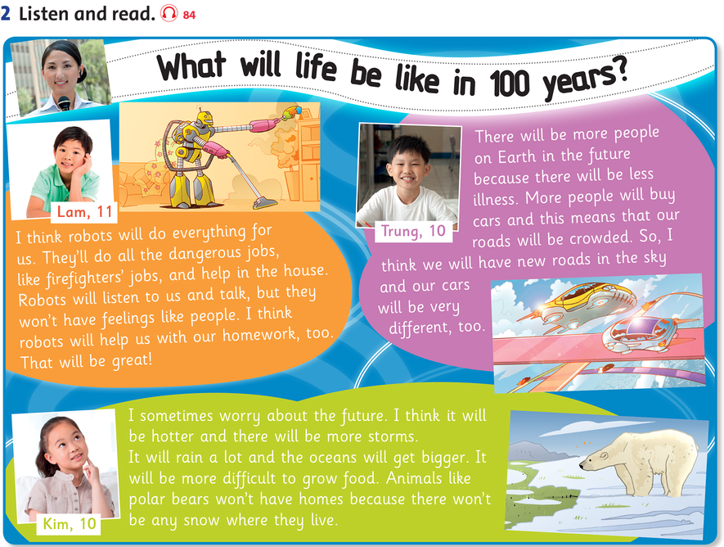
SB page 68
What is the robot doing?
How are people traveling?
housework
car
Which animal can you see?
Polar bear

Slide 7

QUESTIONS
1. What will robots do in the future?
Robot will do everything for us.
2. What will the weather be like?
It will be hotter and more storm.
3. Why will we live longer?
Because there will be less illness.
4. How will we travel?
We will travel by car.

Slide 8







Slide 9

MEANING OF WORDS
feeling (noun): emotion – cảm xúc
I have no feeling in my little finger.
illness (noun): a disease of the body – sự đau ốm
He died at home after a long illness.
crowded (adjective): full of people – đông người
By 10 o’clock the bar was crowded.
road (noun): a route – tuyến đường
Be careful when you cross a main road.
storm (noun): violent weather – bão
A lot of trees came down in the storm.

Slide 10
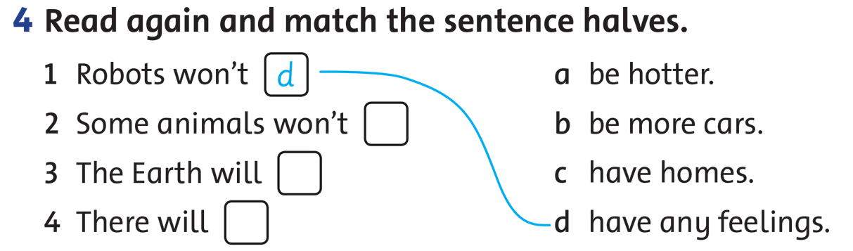
d
c
a
b

Slide 11

Game
“Yes” or “no”
1. Robots will do all our housework.
Yes
2. Children will study at home with computers.
Yes
3.People will live for 200 years.
No
4. Cars will fly in the air.
No
5. Polar bears will become extinct.
No

Slide 12
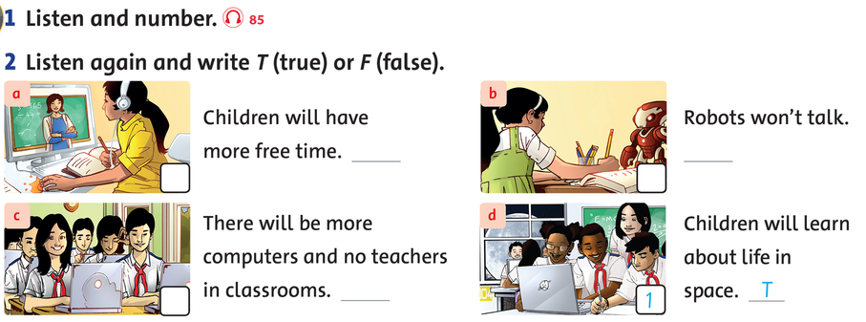
LESSON 6 LISTENING
SB page 69
T
F
2
4
F
T
3
1

Slide 13

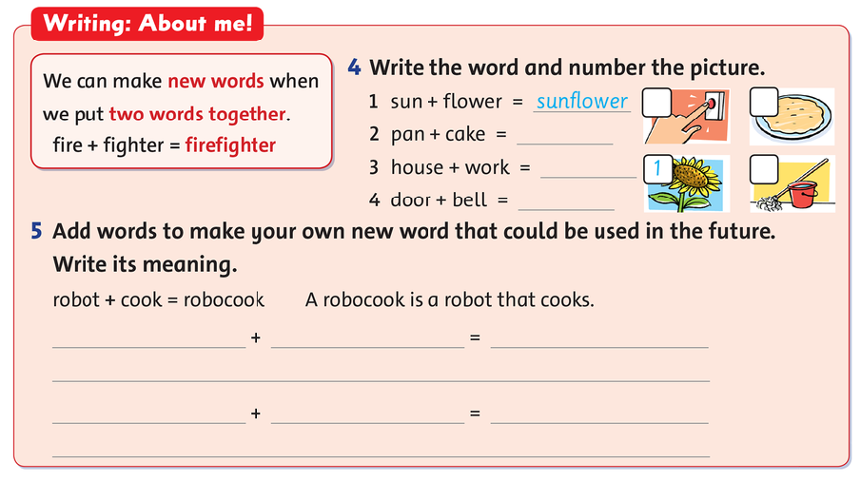
4
2
pancake
housework
3
doorbell
Homework

Slide 14

HOMEWORK
Workbook Page 63, 64

Slide 15
