Slide 1
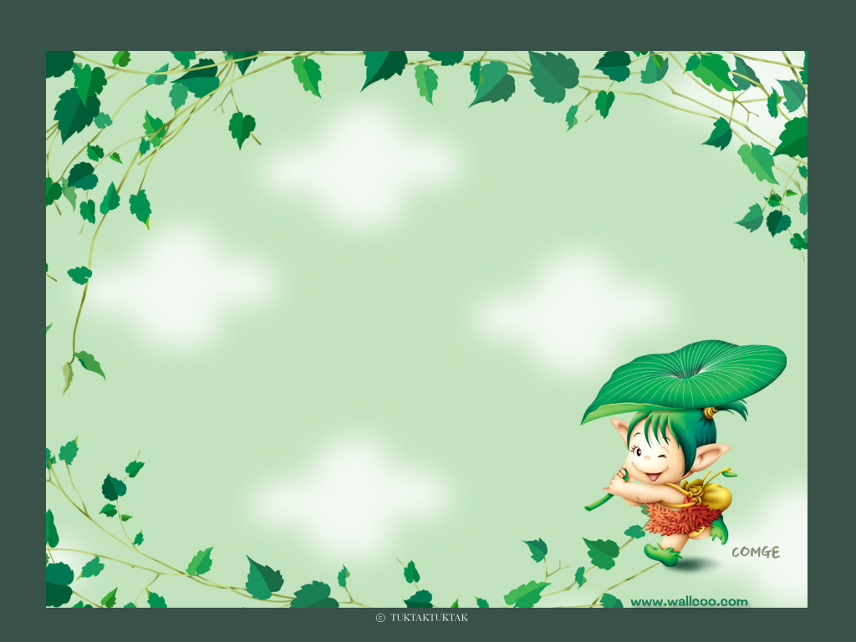
WARMLY
WELCOME TO GRADE 4
Presented by Ms. Nguyệt

Slide 2

Family and Friends special edition– Grade 4
Unit 8
I ‘d like a melon!
Lesson 2 : Grammar

Slide 3
CONTENT
Family and Friends special edition– Grade 4
1. Grammar
2. Practice
3. Homework

Slide 4
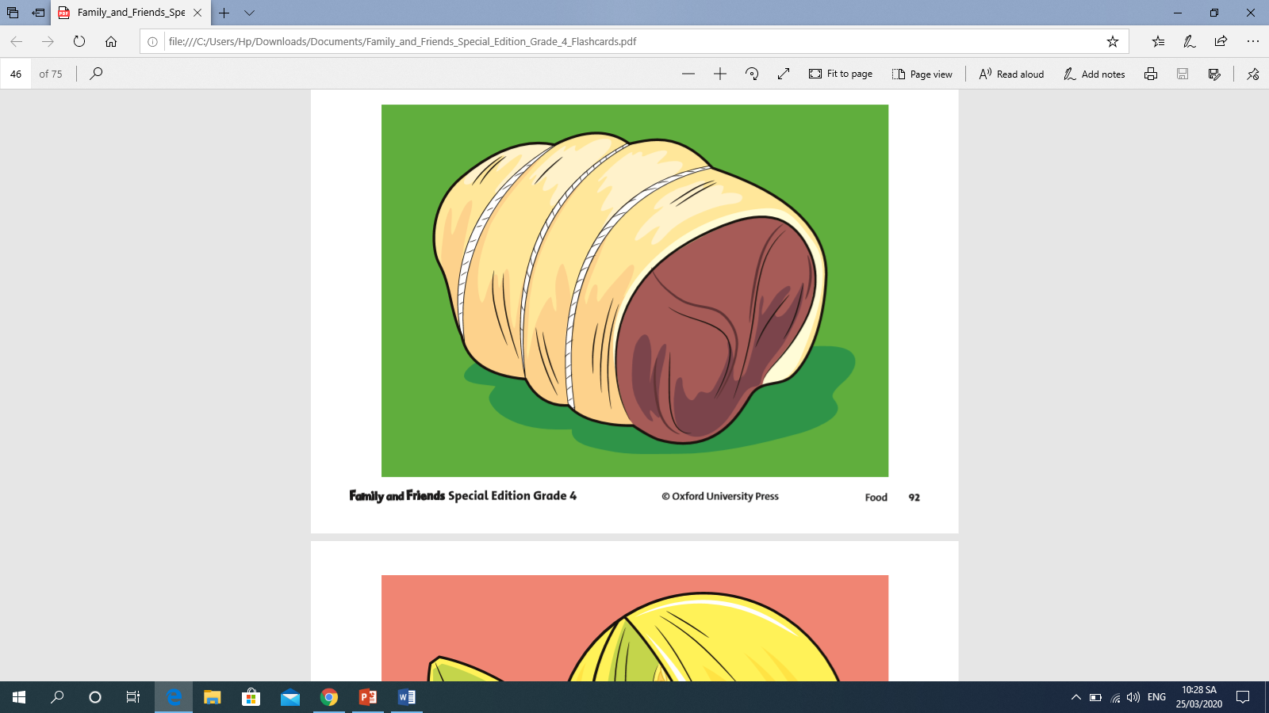
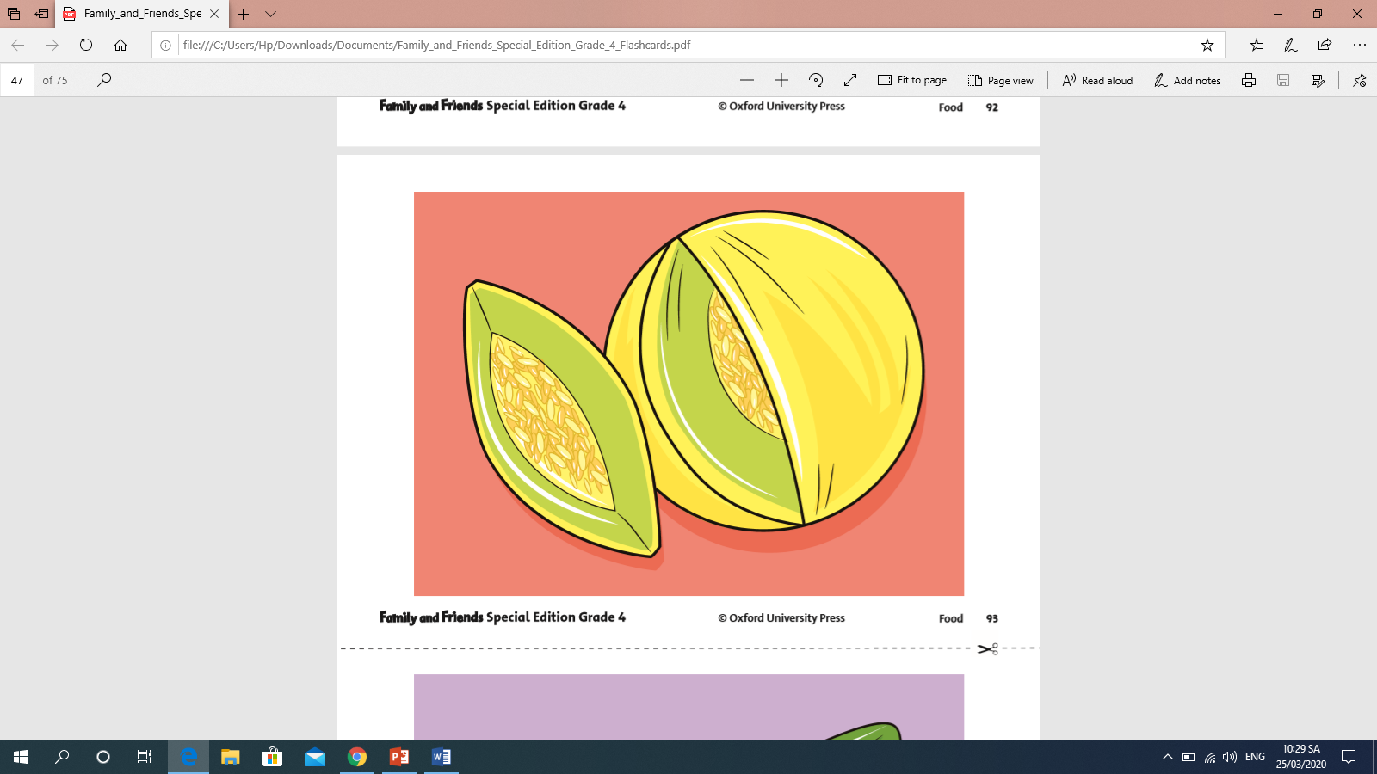
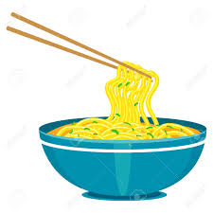
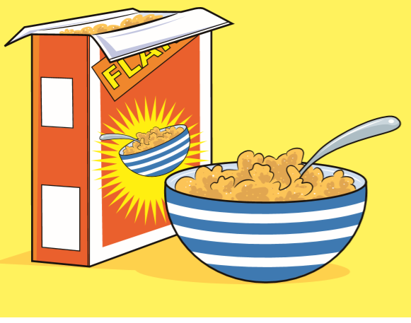

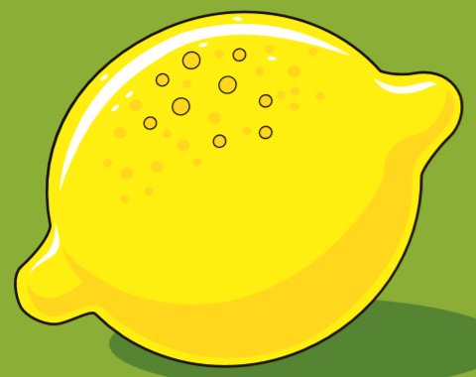
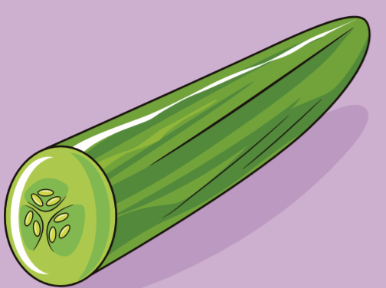
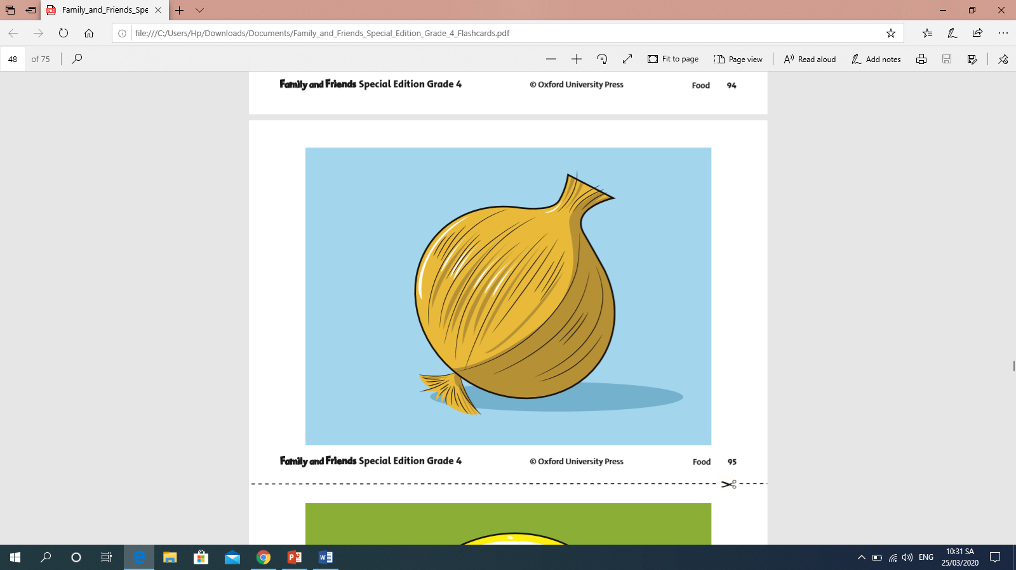
Vocabulary:
Family and Friends special edition– Grade 4
noodles
mì
cereal
ngũ cốc
meat
thịt
melon
dưa gang
Noun
Danh từ
cucumber
dưa leo
onion
hành tây
lemon
chanh

Slide 5
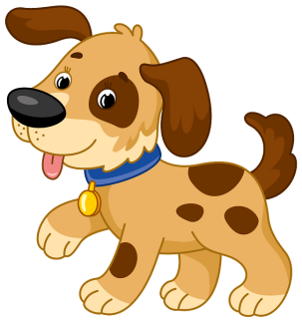
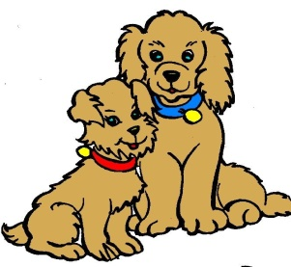
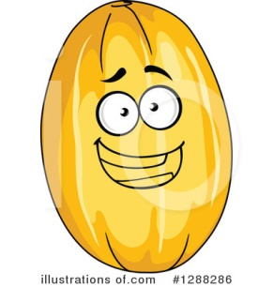
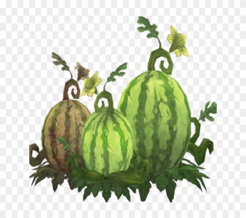
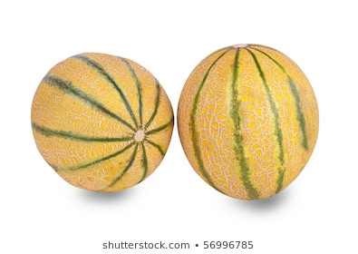
GRAMMAR
Family and Friends special edition– Grade 4
COUNTABLE NOUN (danh từ đếm được)
a dog
two dogs
one melon
two melons
three/ some melons

Slide 6
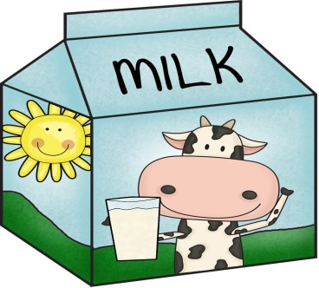
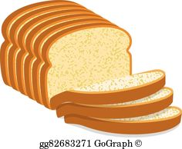



Family and Friends special edition– Grade 4
UNCOUNTABLE NOUN (danh từ không đếm được)
some
bread
milk
some
some
water
some
hair
some
money

Slide 7

STRUCTURES:
Family and Friends special edition– Grade 4
I’d like a melon. We’d like some meat.
Would you like some cereal? Yes, please.  No, thanks.
I’d like = I would like = Tôi muốn

Slide 8

Family and Friends special edition– Grade 4
2. PRACTICE
Exercise 3 (Page 59): Choose a, an or some. Write the words in the correct boxes.
Countable noun Danh từ đếm được | Uncountable noun Danh từ không đếm được
apple salad bread cookie egg rice melon juice water orange
an apple
some salad
a cookie
some bread
an egg
some rice
a melon
some juice
an orange
some water

Slide 9
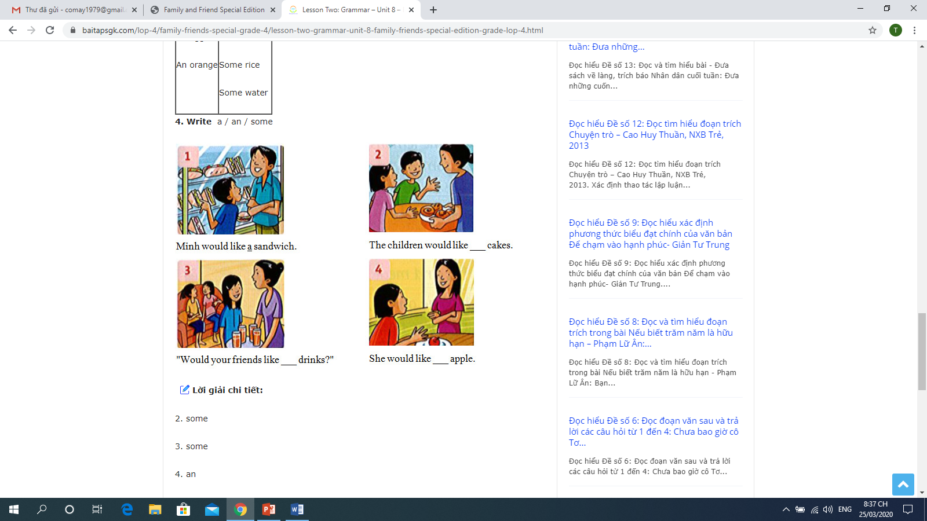
PRACTICE
Exercise 4 (Page 59): Write a an some
Family and Friends special edition– Grade 4
Minh would like ……... sandwich.
The children would like ……... cakes.
a
some
Would your friends like ……... drinks.
She would like ……... apple.
some
an

Slide 10

1. Grammar
Family and Friends special edition– Grade 4
Countable noun Danh từ đếm được | Uncountable noun Danh từ không đếm được
One melon Two melons Three melons Some melons | Some bread
2. Home work: Workbook, page 54, 55.

Slide 11
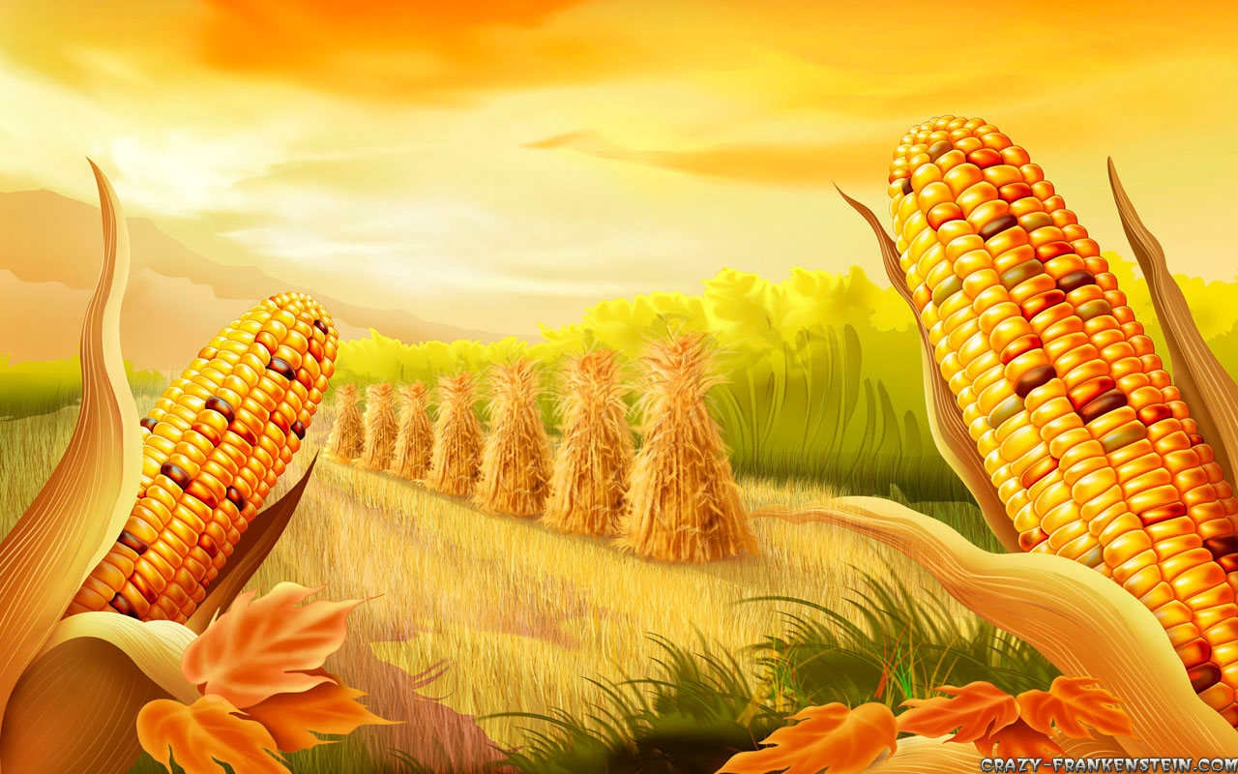
Many Thanks for your attendants.
Good bye!

