Slide 1
PEOPLE’S COMMITTEE OF DISTRICT 12 NGUYEN DU PRIMARY SCHOOL
WARMLY WELCOME TO GRADE 4
Presented by Ms. Nguyệt

Slide 2
Unit 9
Family and Friends special edition– Grade 4
What’s the fastest animal in the world?
Skills time
Lesson 5 and 6 :

Slide 3
CONTENT
Family and Friends special edition– Grade 4
1. Reading
2. Listening
3. Speaking
4. Writing
5. Homework

Slide 4
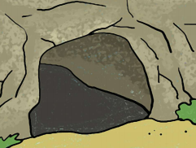
Vocabulary
Family and Friends special edition– Grade 4
river
world
cave
(dòng sông)
(thế giới)
(hang, động)
building
island
(hòn đảo)
(cao ốc)

Slide 5
Family and Friends special edition– Grade 4
1. READING

Slide 6
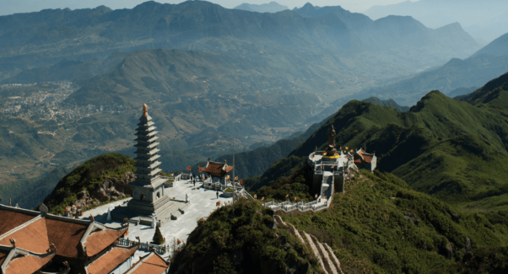
Family and Friends special edition– Grade 4
Fansipan mountain

Slide 7
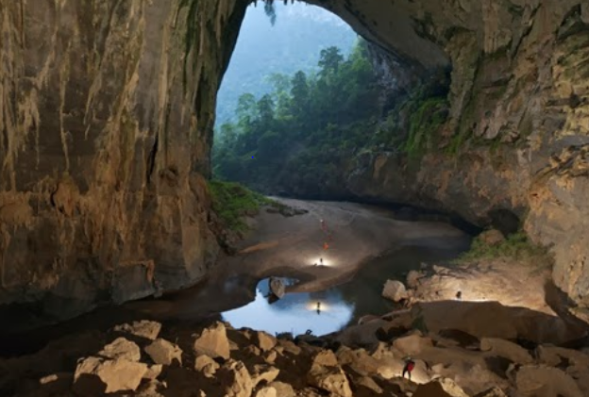
Family and Friends special edition– Grade 4
Son Doong cave

Slide 8
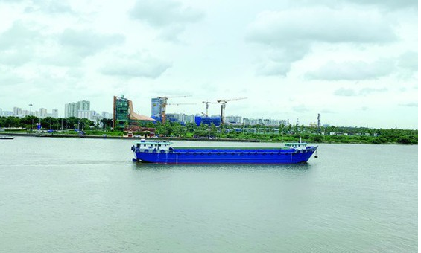
Dong Nai river

Slide 9
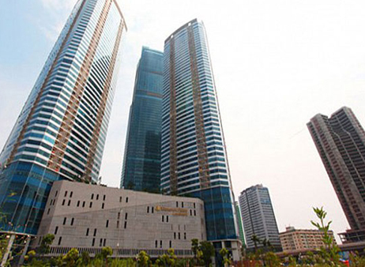
Family and Friends special edition– Grade 4
Family and Friends special edition– Grade 4
Keangnam Ha Noi Landmark tower

Slide 10
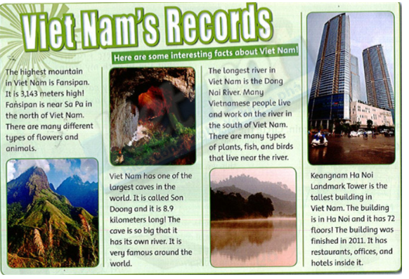
Family and Friends special edition– Grade 4
Vietnam’s records
Family and Friends special edition– Grade 4

Slide 11
Communicative activity
Family and Friends special edition– Grade 4
The highest mountain in Viet Nam is Fansipan.
What’s the highest mountain in Viet Nam?
It’s 3,143 meters high.
How high is it?

Slide 12
Family and Friends special edition– Grade 4
The largest cave in Viet Nam is Son Doong.
What’s the largest cave in Viet Nam?
It’s 8.9 kilometers long.
How long is it?

Slide 13
Family and Friends special edition– Grade 4
The longest river in Viet Nam is Dong Nai.
What’s the longest river in Viet Nam?
No, it isn’t. It’s in the south.
Is it in the north of Viet Nam?

Slide 14
Family and Friends special edition– Grade 4
The tallest building in Viet Nam is Keangnam Ha Noi Landmark Tower.
What’s the tallest building in Viet Nam?
It has 72 floors.
How many floors does it have?

Slide 15
Practice
Family and Friends special edition– Grade 4
4. Read again and match the sentence halves.
1
Fansipan.
c
a. is the tallest building in Viet Nam.
2
Son Doong
d
b. is the longest river in Viet Nam.
b
c. is the highest mountain in Viet Nam
3
The Dong Nai river
Keangnam Ha Noi Landmark Tower.
a
d. is the largest cave in Viet Nam.
4

Slide 16
Listening
Family and Friends special edition– Grade 4
1
Listen and complete the table
What?
Name?
highest
island
1
highest
mountain
Fansipan
biggest
beach
2
biggest
lake
Ba Be
largest
lake
3
longest
beach
Tra Co
longest
mountain
island
Phu Quoc
4
largest

Slide 17
Speaking: Ask and answer:
Family and Friends special edition– Grade 4
What’s the highest mountain in Viet Nam ?
1
It’s Fansipan.
2
What’s the biggest lake in Viet Nam?
It’s Ba Be.
3
What’s the longest beach ?
It’s Tra Co.
4
What’s the largest island in Vietnam?`
It’s Phu Quoc.

Slide 18
Writing:
Adverbs of frequency (trạng từ chỉ tần suất):
always: luôn luôn,
never: không bao giờ,
sometimes: thỉnh thoảng
Ex:
I always go to the shopping mall.
I never go to the shopping mall.
Note:
I sometimes eat fastfood.
I eat fastfood sometimes.
Sometimes I eat fastfood.

Slide 19
Family and Friends special edition– Grade 4
Practice:
3. Are these sentences correct?
4.
The boys always play basketball.
V
1.
She sometimes plays chess.
V
Always I go swimming on Saturday.
X
2.
Lan cooks never.
X
5.
3.
V
6.
You watch DVD sometimes.
V
I always go to the lake on vacation.
V

Slide 20
Family and Friends special edition– Grade 4
4. Write about you. Complete the sentence
1. I always
have dinner at 7 p.m
2. I always
do homework at 8 p.m
3. I sometimes
go to the library on Saturday.
4. I never
eat fast food at night.

Slide 21
1. words
Family and Friends special edition– Grade 4
world(n): thế giới
cave(n): hang, động
river(n): sông
building(n): cao ốc
island(n): hòn đảo
2. Adverbs of frequency
(trạng từ chỉ tầng suất)
always: luôn luôn
never: không bao giờ
sometimes: thỉnh thoảng

Slide 22
Family and Friends special edition– Grade 4
3. Homework: Workbook, page 64 and 65.

Slide 23
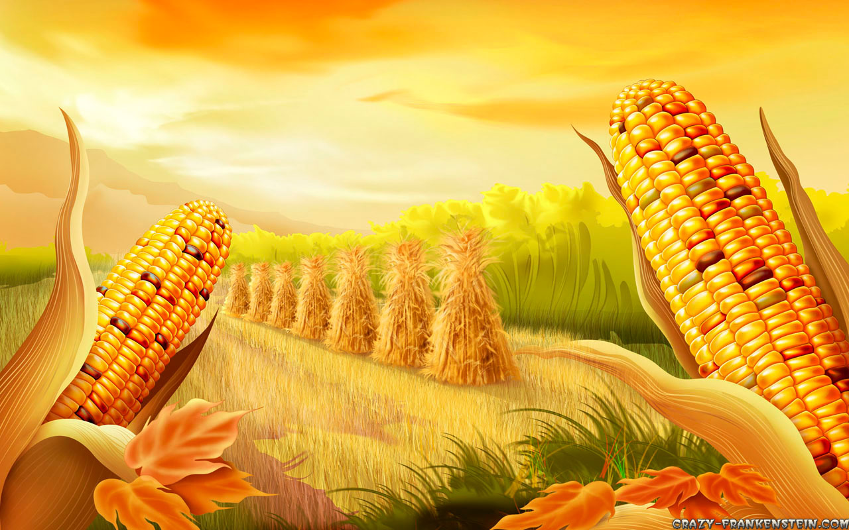
Family and Friends special edition– Grade 4
Many Thanks for your attendants.
Stay safe & good bye!

