Slide 1

Nguyen Du Primary School
Subject: English
Grade: 2

Slide 2
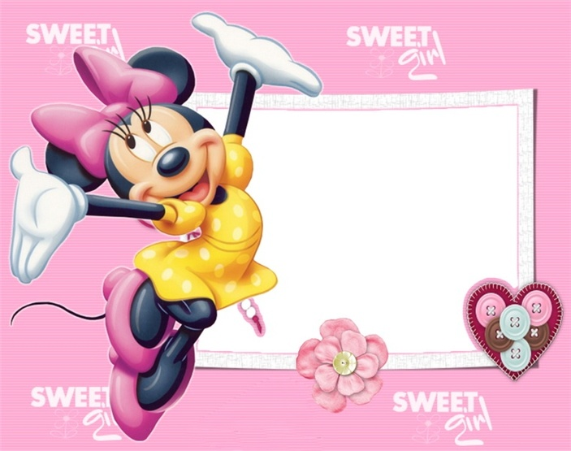
I learn Smart Start Grade 2- Special Edition
Theme 7: Animals
Lesson 1:

Slide 3
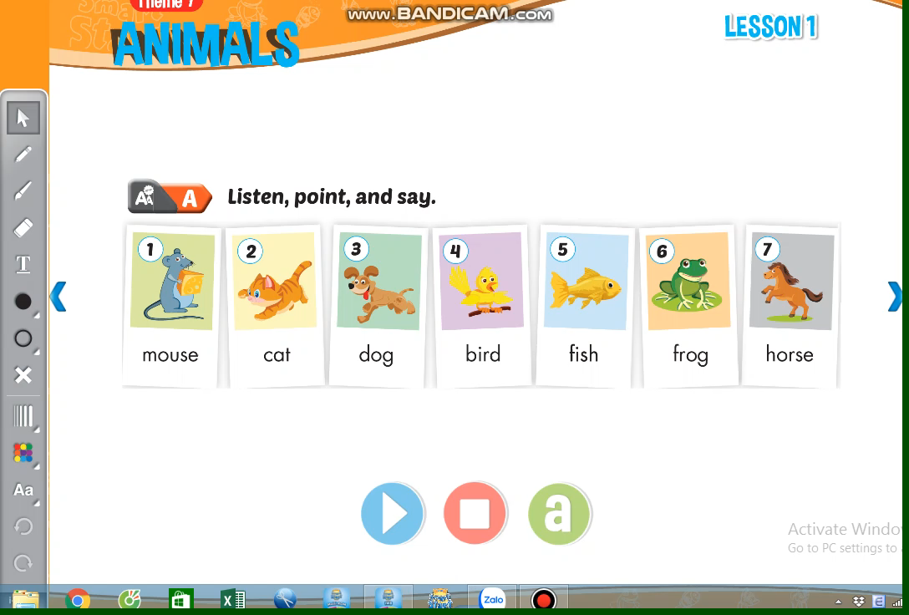

Slide 4
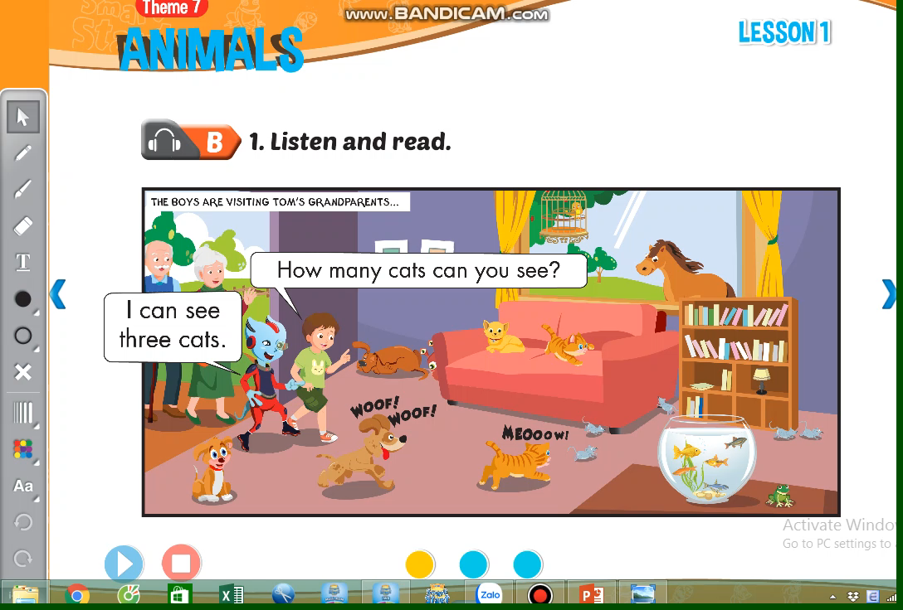

Slide 5
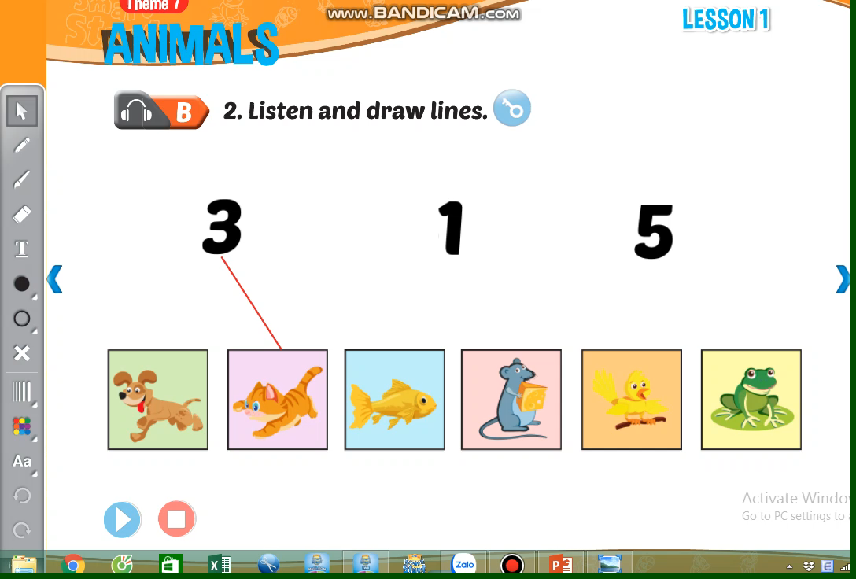

Slide 6
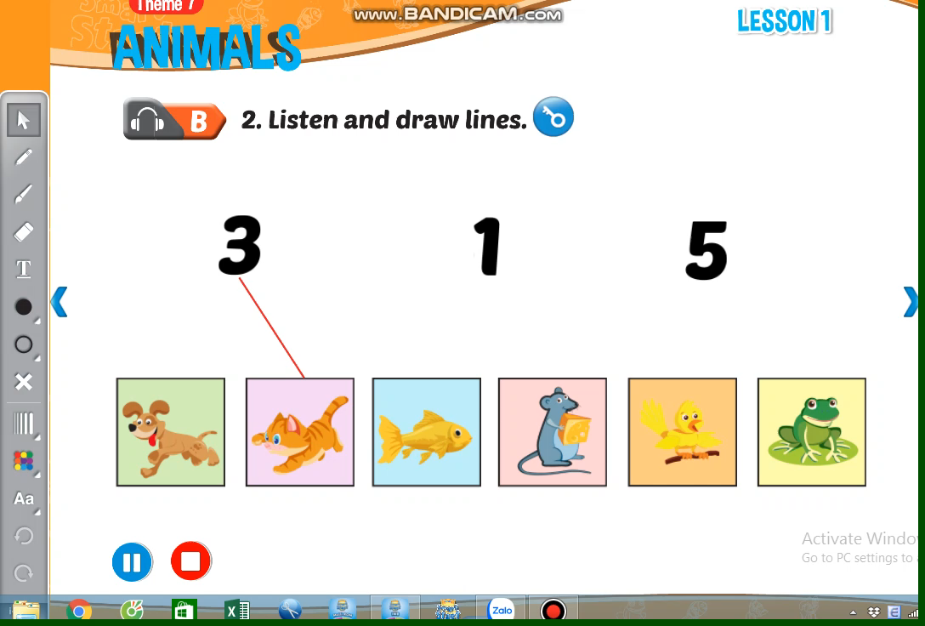

Slide 7
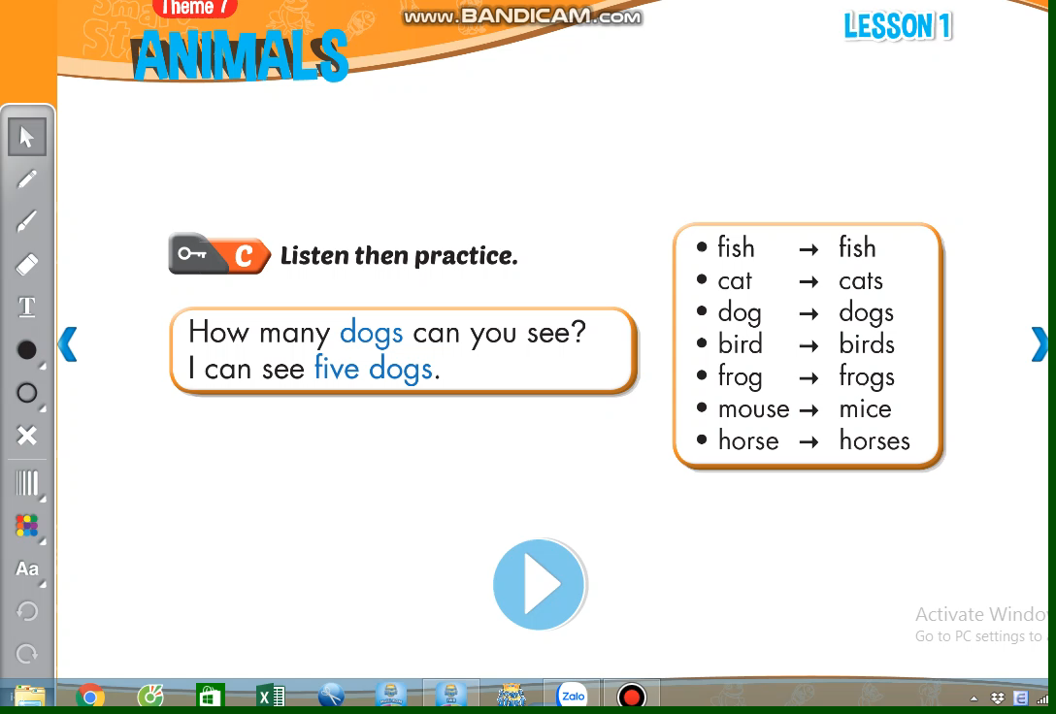

Slide 8
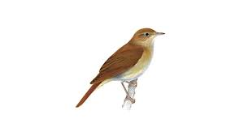
How many birds can you see?
I can see three birds

Slide 9

How many fish can you see?
I can see five fish

Slide 10

sing a song

Slide 11
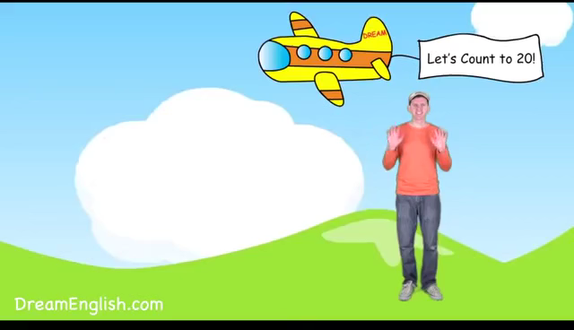

Slide 12
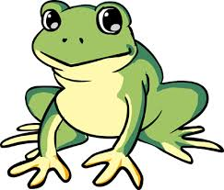
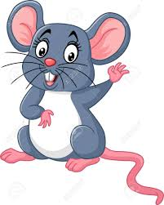
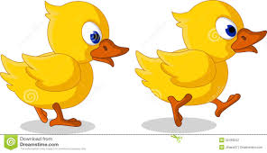
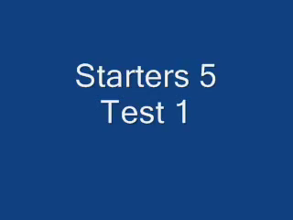
Exercise 1: Look and write.
1. How may frogs can you see?
I can see two frogs
2. How many mice can you see?
I can see ……………..……
3. How many ducks can you see?
I can see ……………..……
4. How many fish can you see?
I can see …………..

Slide 13
Exercise 1: Look and write.
1. How may frogs can you see?
I can see two frogs .
2. How many mice can you see?
I can see three mice .
3. How many ducks can you see?
I can see two ducks.
4. How many fish can you see?
I can see five fish

Slide 14





Homework
Learn new words
Copy 3 lines
Do workbook P.62,63
Goodbye

