Slide 1
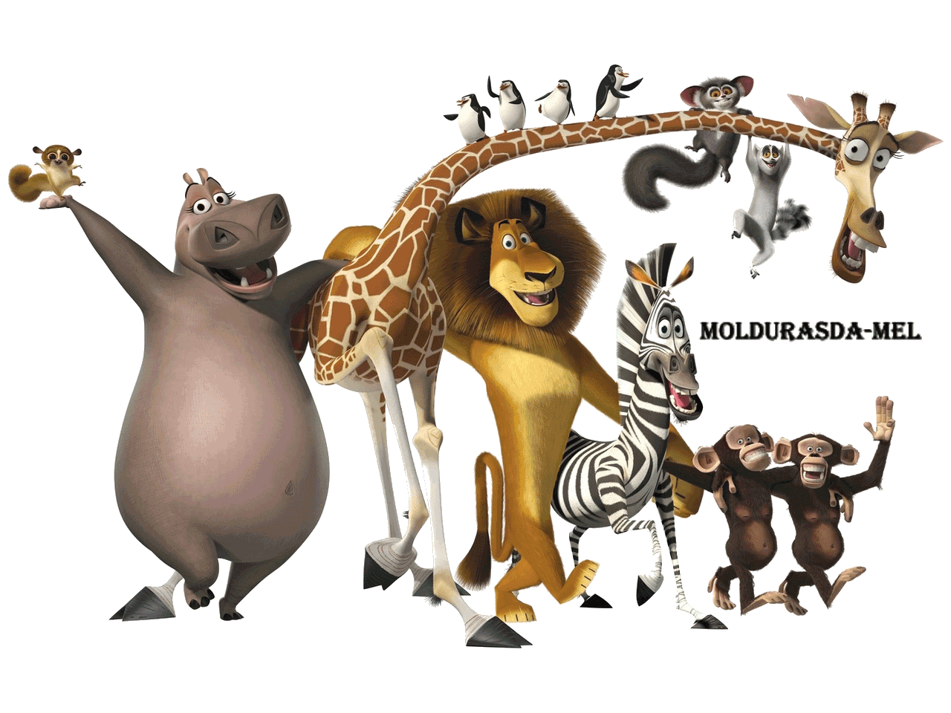
Family and friends
Grade 3

Slide 2
Unit 9 (continued)
Lesson 2 - Grammar
Table of contents:
Vocabulary revision
2. Grammar point
3. Practice exercises

Slide 3
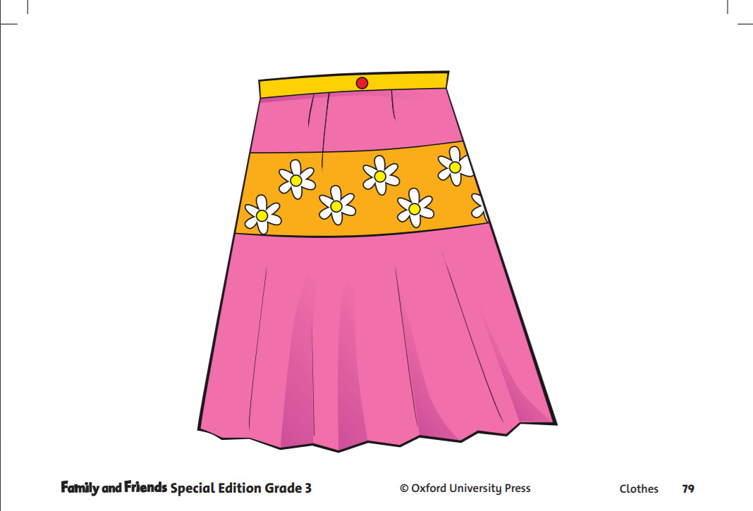
Vocabulary revision
Skirt

Slide 4
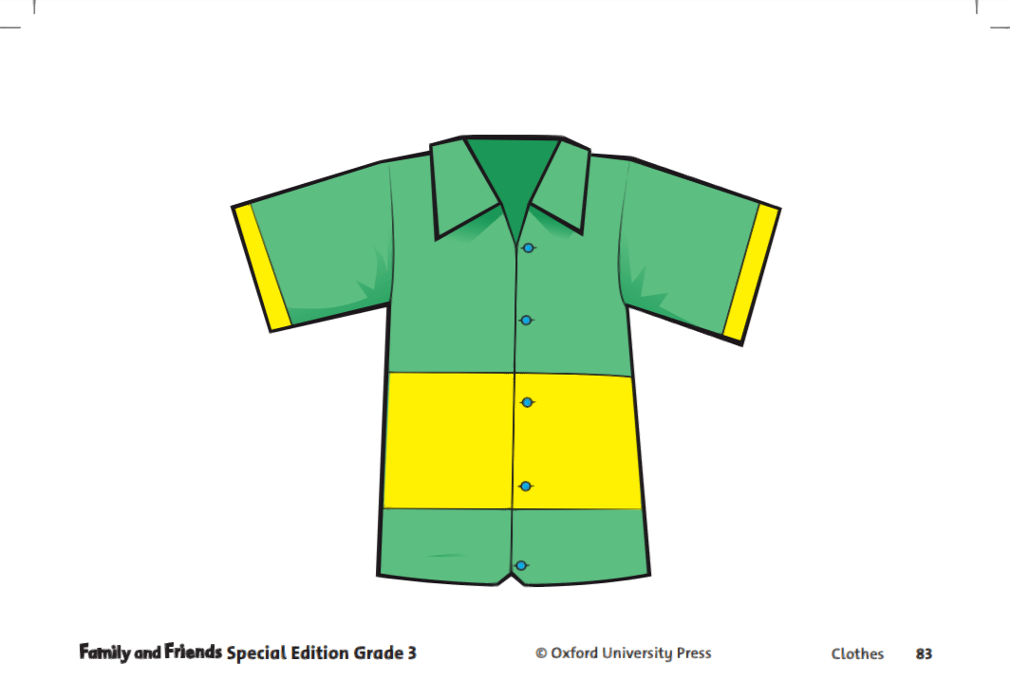
Vocabulary revision
Shirt

Slide 5
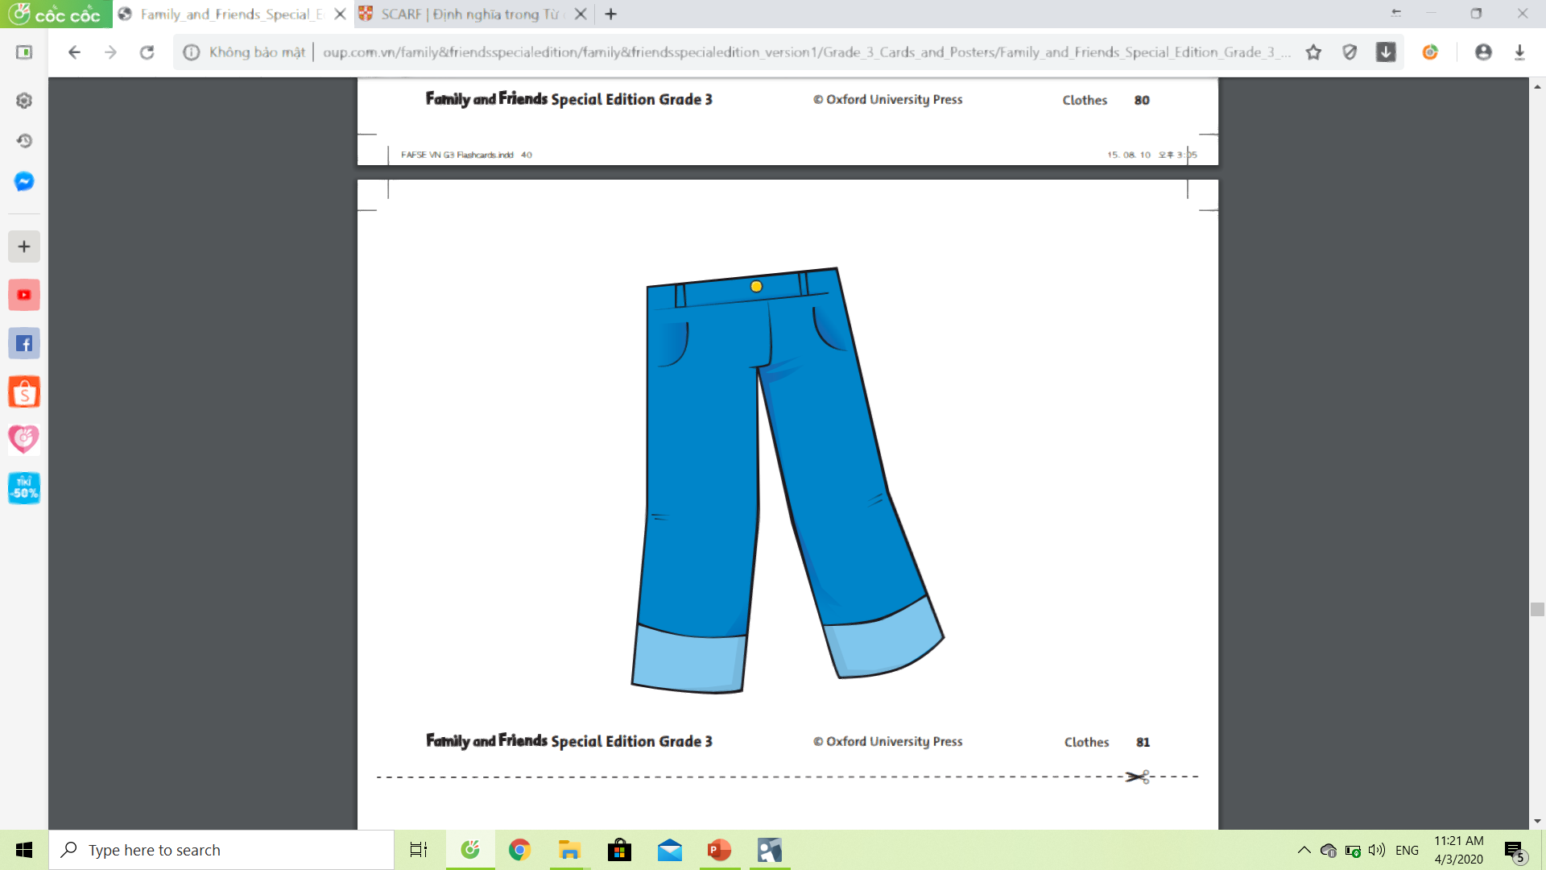
Vocabulary revision
Jeans

Slide 6
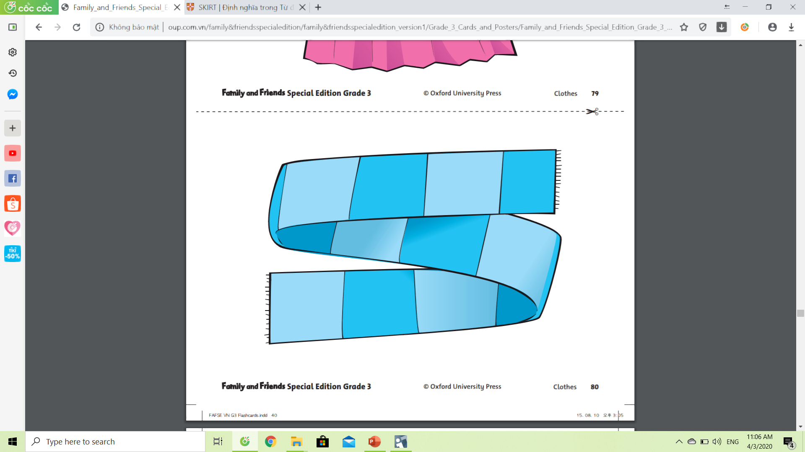
Vocabulary revision
Scarf

Slide 7
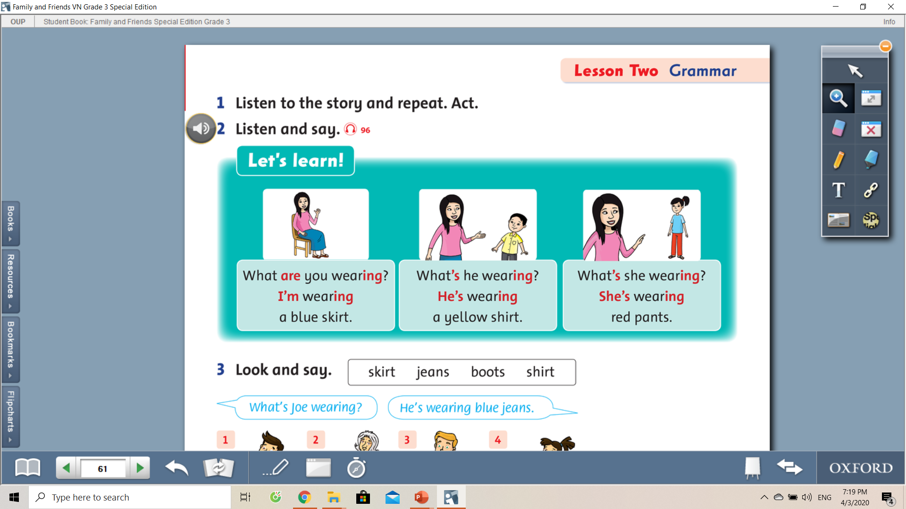
2. Grammar point

Slide 8

2. Grammar point
Listen again and repeat

Slide 9
2. Grammar point
Listen again and repeat

Slide 10
What are you wearing ?
What
are you wearing
?
are
wear
+ ing
(to be)
( verb)
+ ing
Am
Is
+
wearing
Are

Slide 11
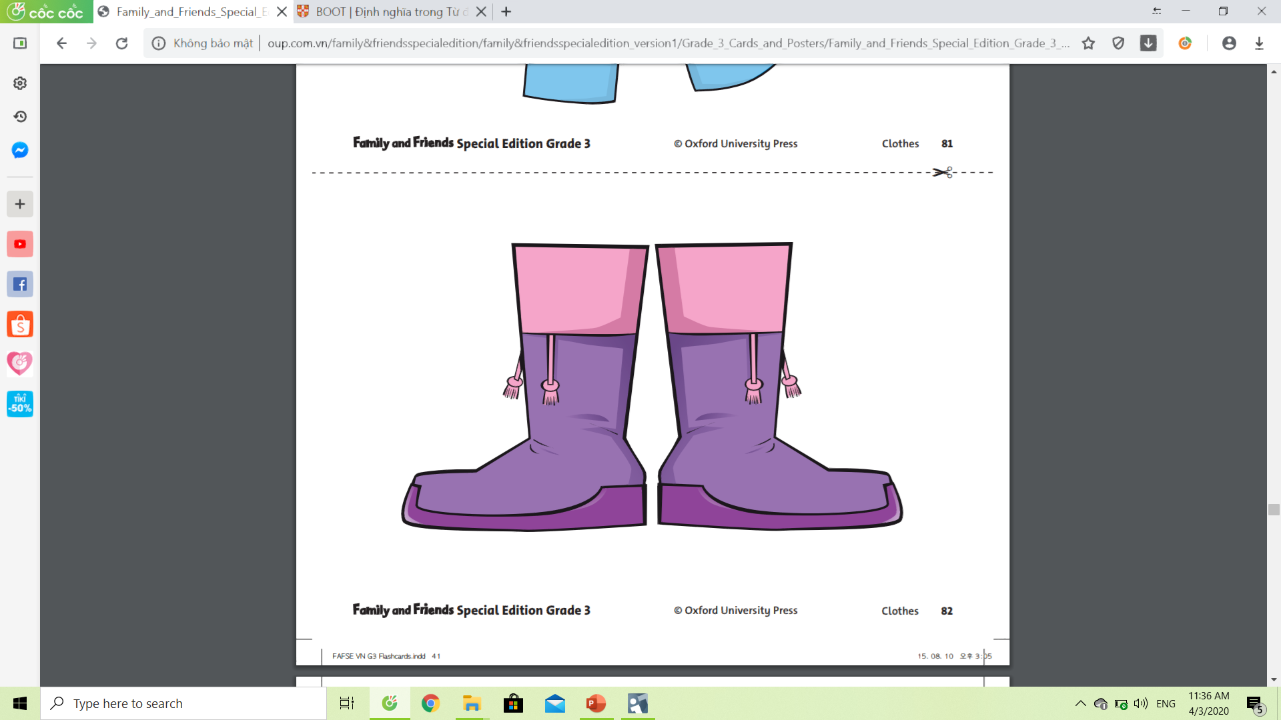
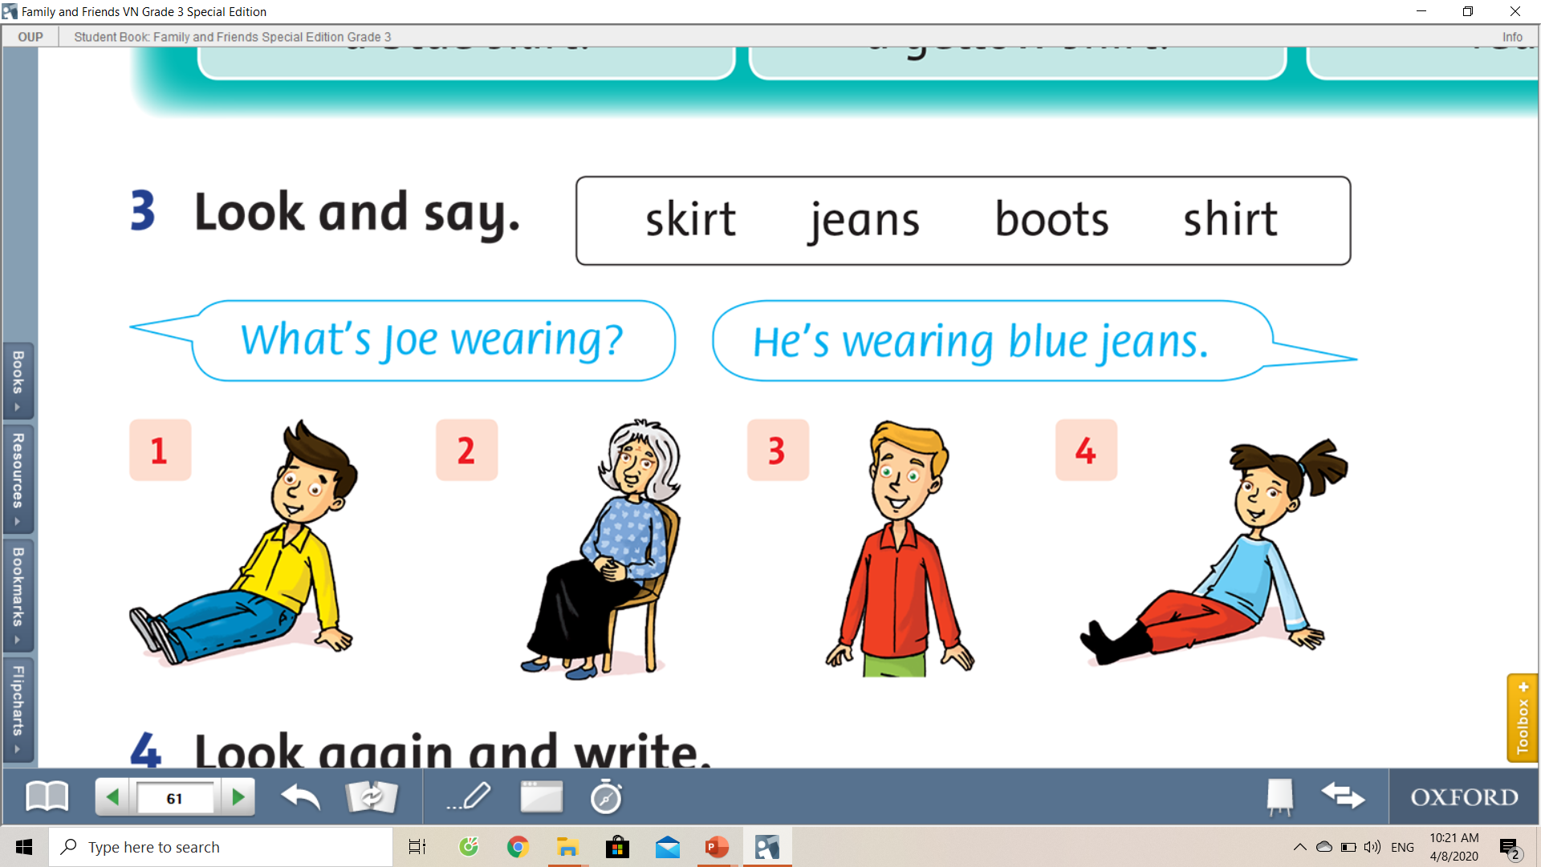
Joe
Grandma
Tim
Milly

Slide 12
Joe
Grandma
Tim
Milly
What’s Joe wearing?
Jeans
What color is it?
Blue
‘s
wear
He
ing
a blue jeans.
‘s = is

Slide 13
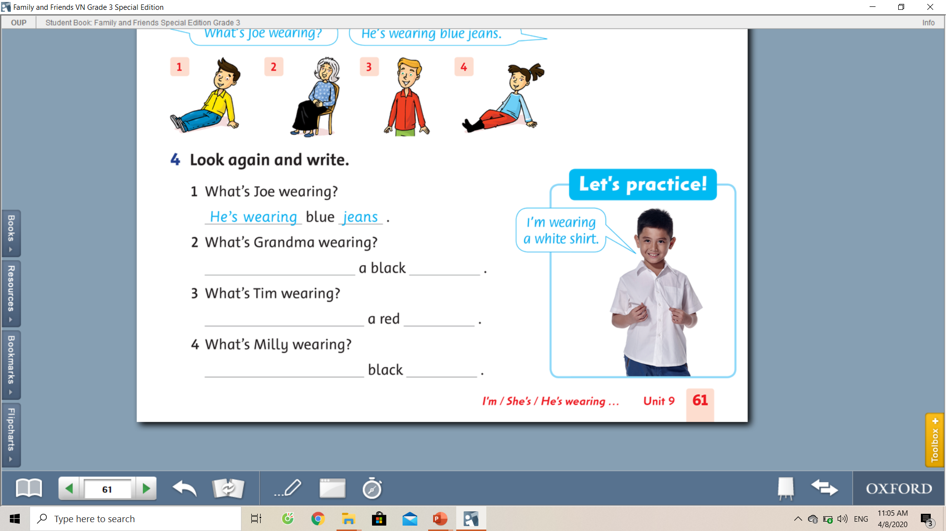
She’s wearing
skirt
He’s wearing
shirt
She’s wearing
boots

Slide 14
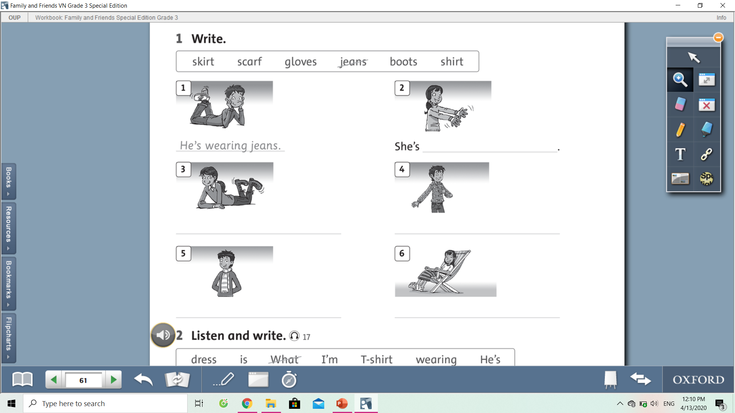
3. Practice exercises
wearing gloves
She’s wearing boots.
He’s wearing a shirt.
He’s wearing a scarf.
She’s wearing a skirt.

Slide 15
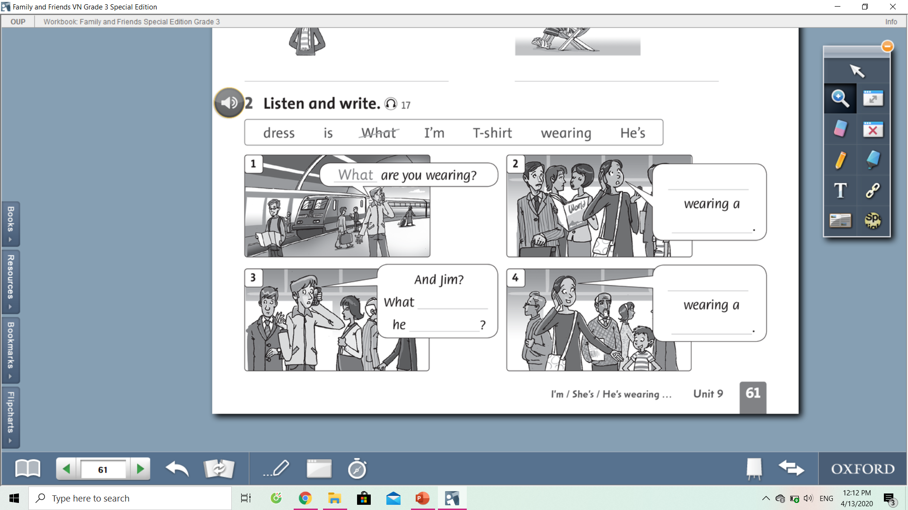
I’m
dress
He’s
is
wearing
T-shirt

Slide 16
3. Practice exercises

Slide 17
I’m
dress
He’s
is
wearing
T-shirt

Slide 18
Good bye everyone!
Don’t forget to do your exercises.
Stay at home and be safe!
Zalo: 0949759157
Cellphones: 0961953094

