Slide 1
Unit 11:
Something new to watch!

Slide 2
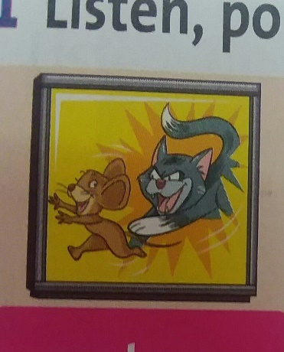
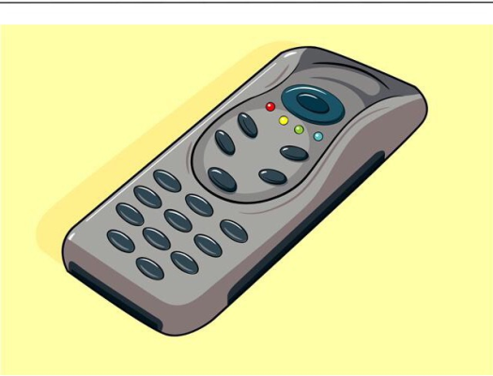
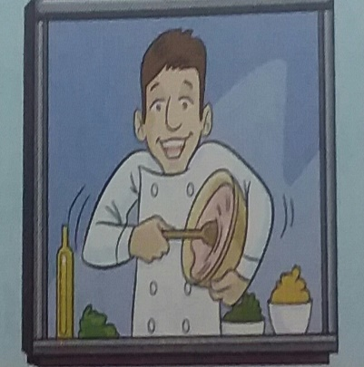
New words:
the news documentary channel
advertisement remote control tv show cellphone
cartoon

Slide 3
Explain the words:
argue: speak angrily to somebody
Ex: argue with somebody
show: a programme on television or the radio
Ex: a film show
turn on: start # turn off
Ex: turn on the light.

Slide 4
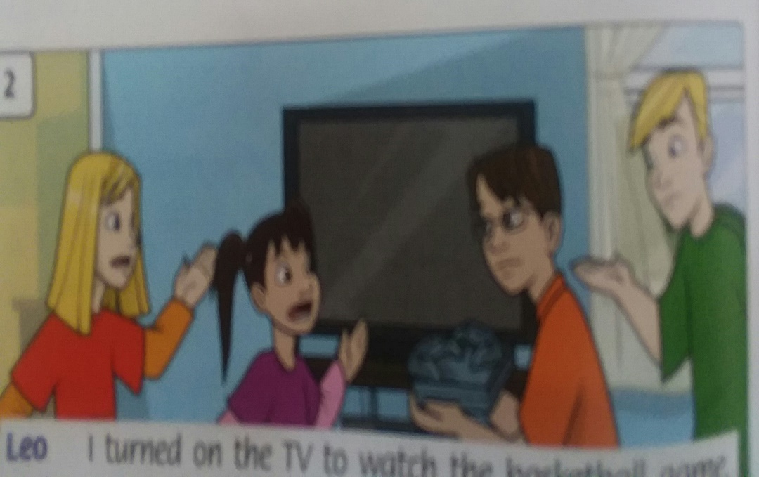
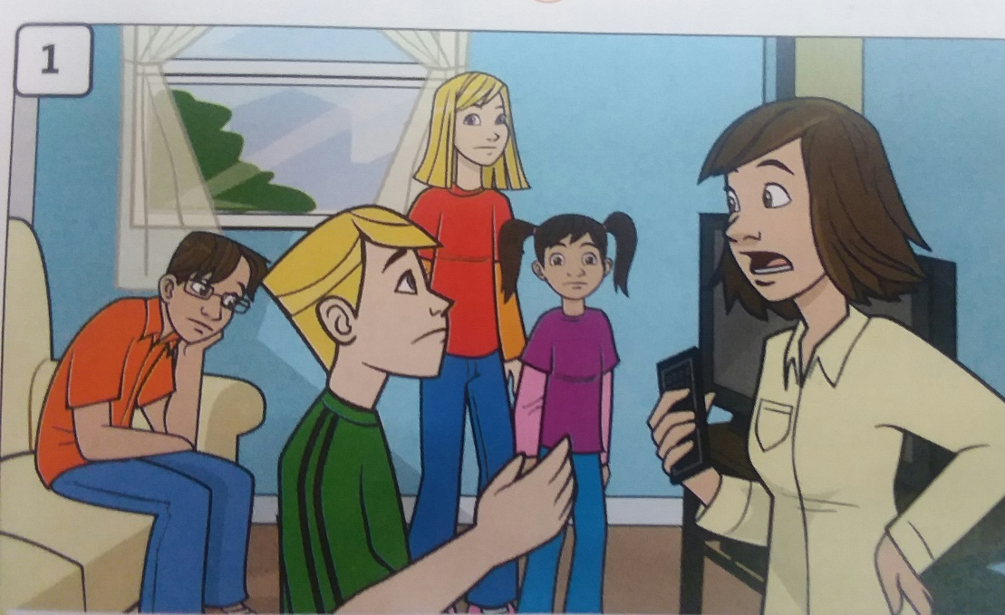
Learn to read:
Leo: I turned on the TV to watch the basketball game.
Amy: Well, my favourite show is on now.
Holly: Can I watch it, please?
Aunt: Why are you arguing?

Slide 5
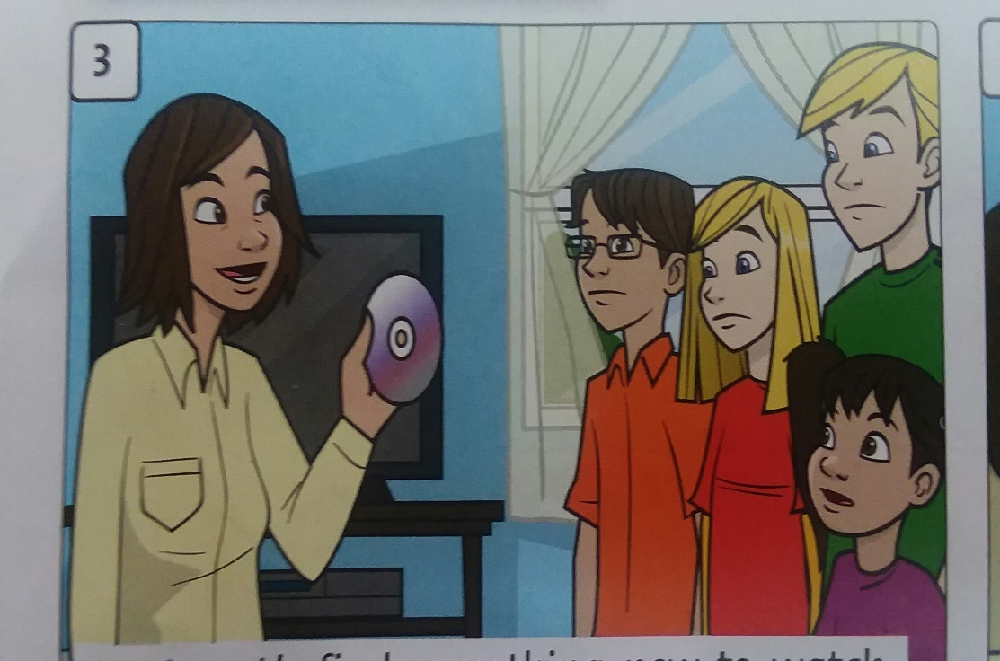
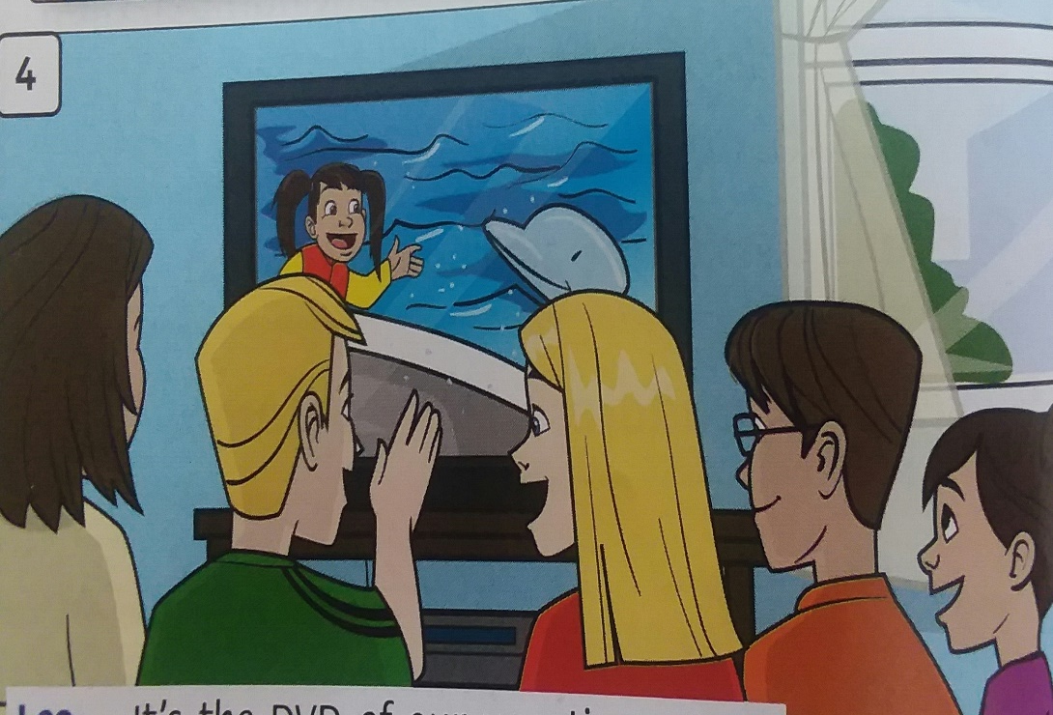
Aunt: Let’s find something new to watch. How about this new DVD?
Max: What is it?
Aunt: Put it on. Then you’ll see.
Leo: It’s the DVD of our vacation. Wow!
Max: Thanks.It is much better than arguing!

Slide 6
THE END OF THE LESSON

